Slide 1
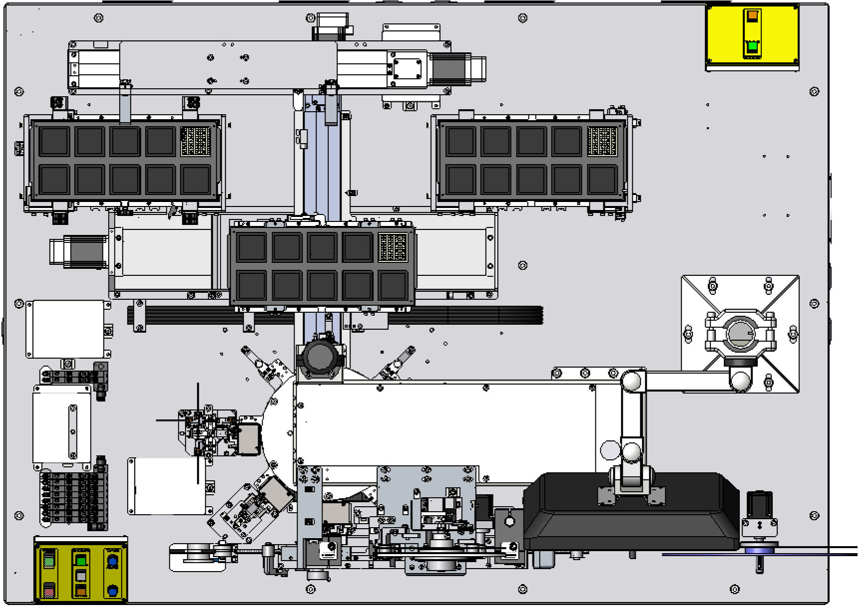
Tray Unloader
Tray Loader
Rotatory
X/Y Table
Top CCD
(Optional)
Fail Bin Box
(Optional)
Precision Module
IC Rotate Module
Pocket CCD
Inspection
After Taping
(Optional)
Reel Unloader
Taping Module

