Slide 1
CRH220P_測試區相關
Test area related
wenguang 2025/04/08

Slide 2
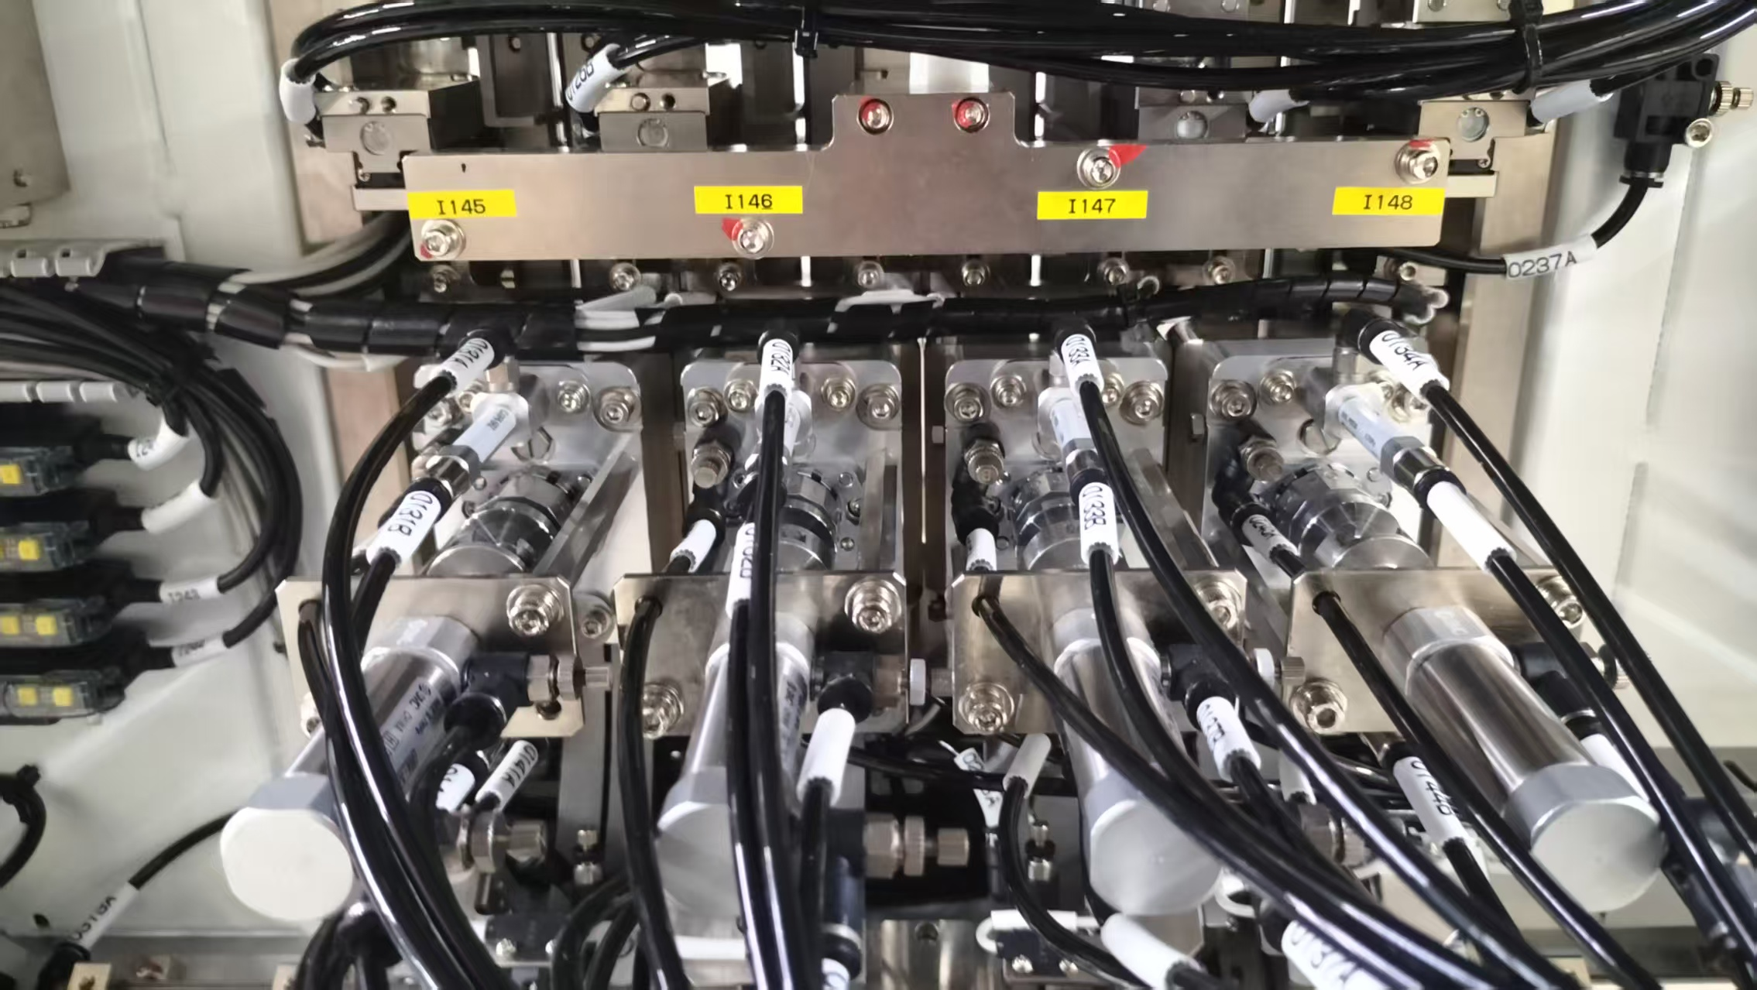
CRH220P_測試區相關
Test area related
1 pin1 位置調整方式
2 Bady stop 調整方式
3 測試區深度調整方式
1 pin1 position adjustment method
2 Bady stop adjustment method
3. Test area depth adjustment method
Test area related

Slide 3
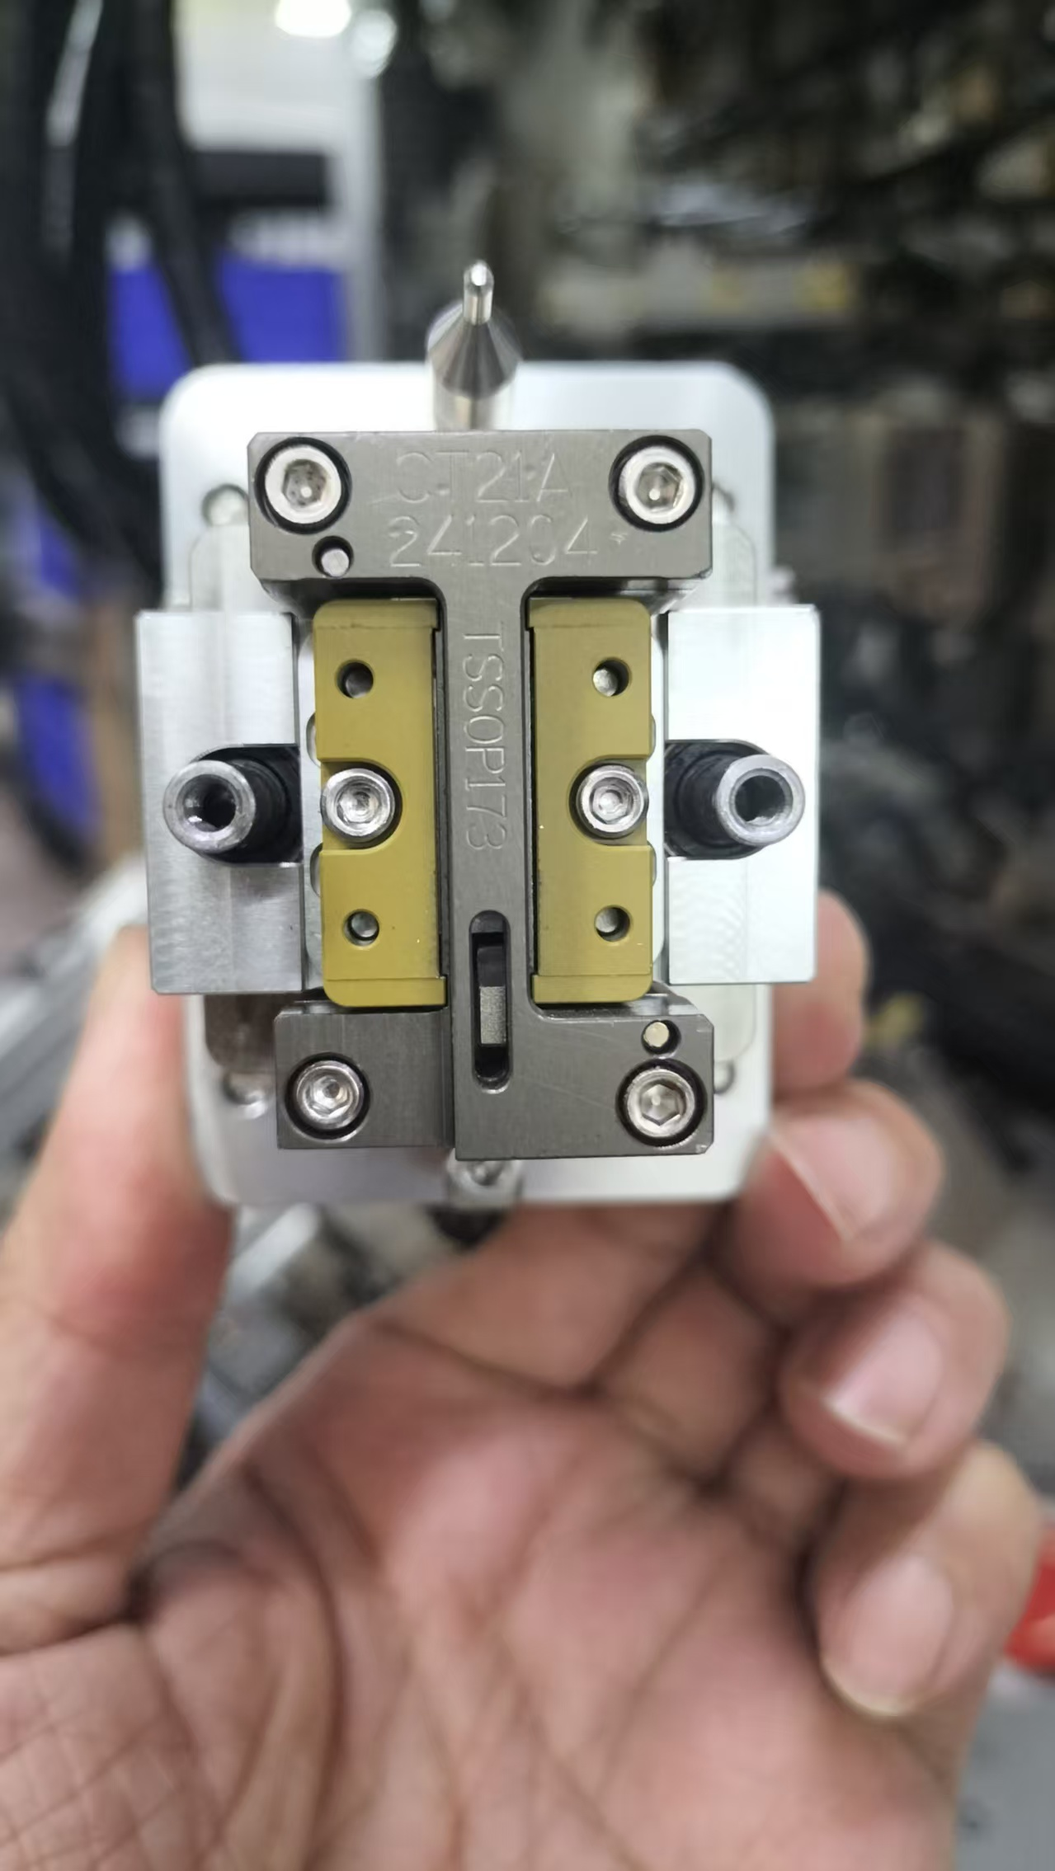
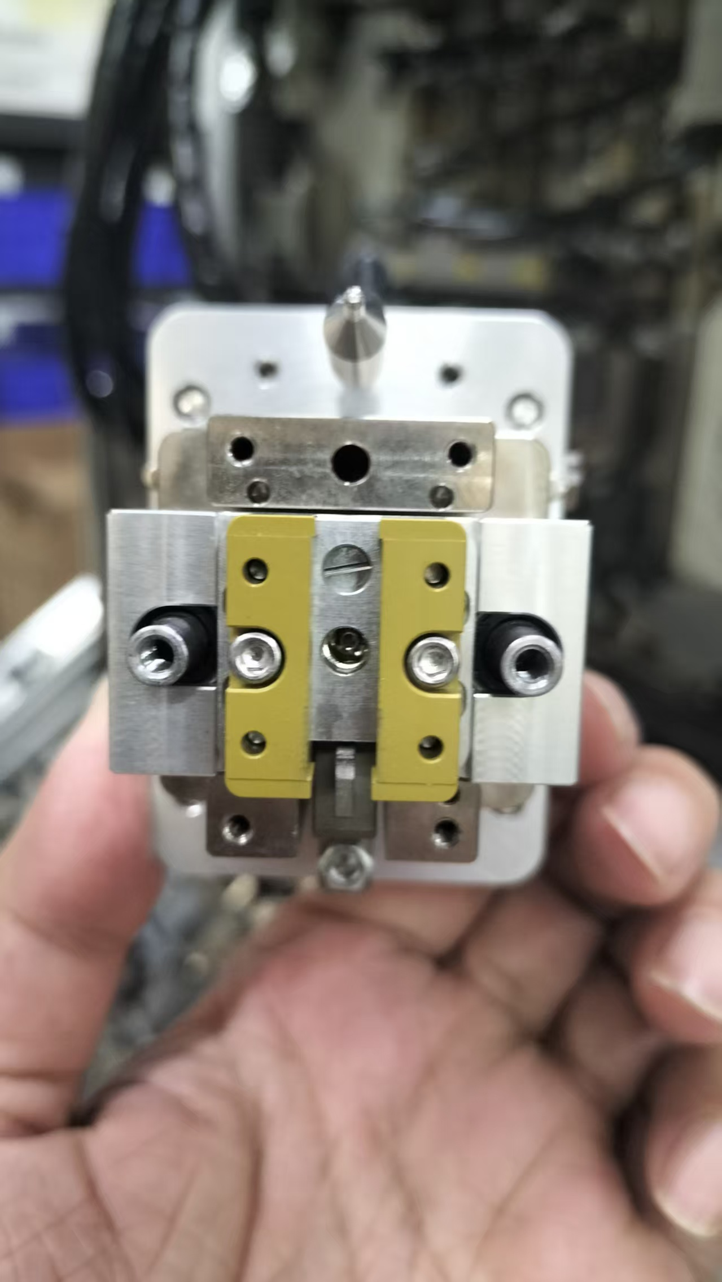
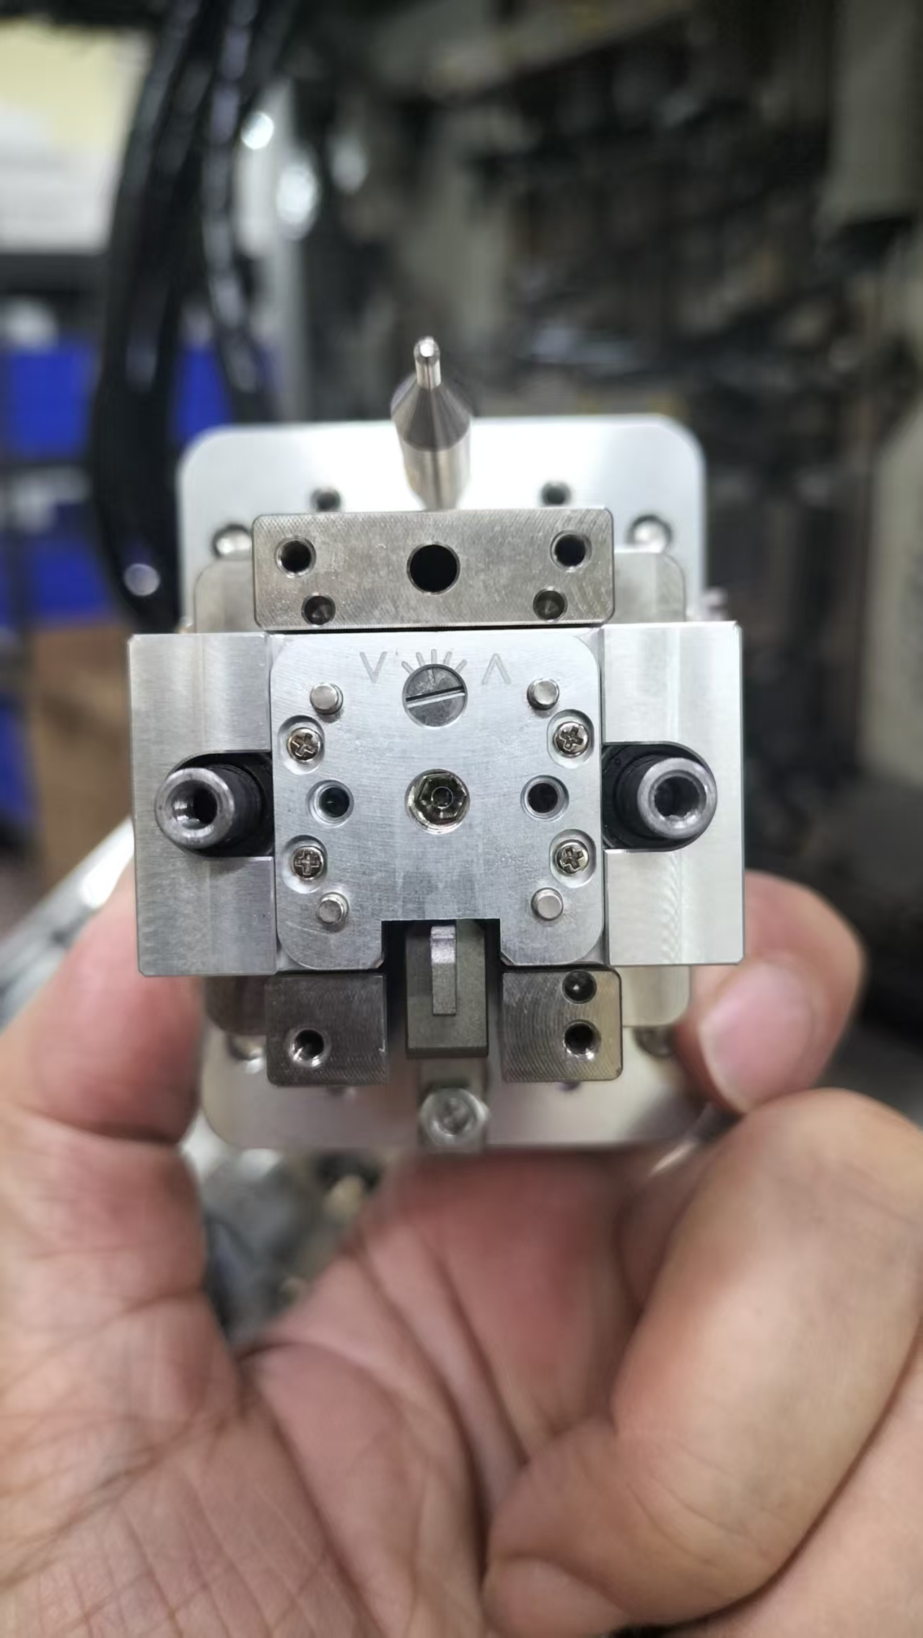
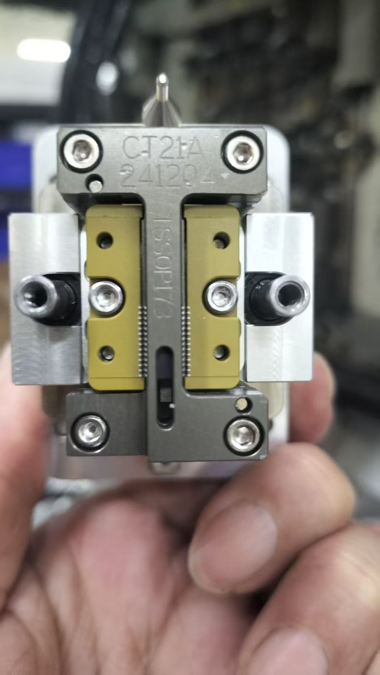
CRH220P_測試區相關
Test area related
Pin1 position adjustment method
1 Remove the I-rail screws(4 EA)
2 Remove the lead stop screw(2 EA)
3 Loosen the cross screw(4EA) and adjust the height of pin1
4 When IC is under pressure test, it can slide to the bottom and IC can be moved manually
Pin1 位置調整方式
1 將工字軌螺絲拆除(四顆)
2 將Lead stop 螺絲拆除(二顆)
3 將十字螺絲放鬆(四顆),調整pin1高度
4 IC壓測時,可滑到底,手動也可以移動IC
Test area related

Slide 4
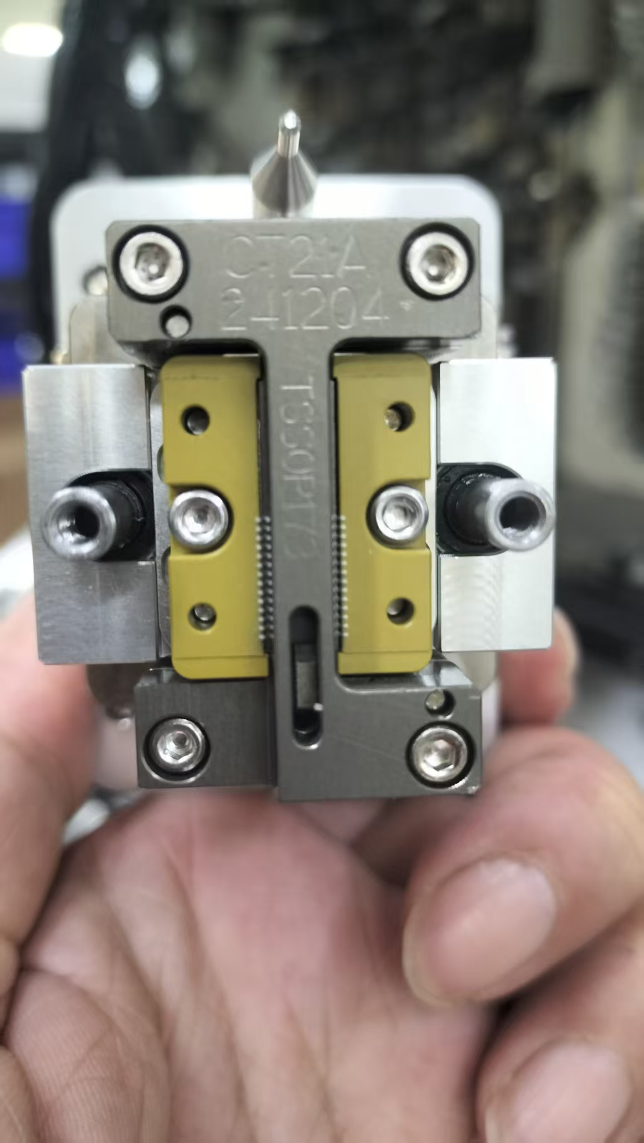
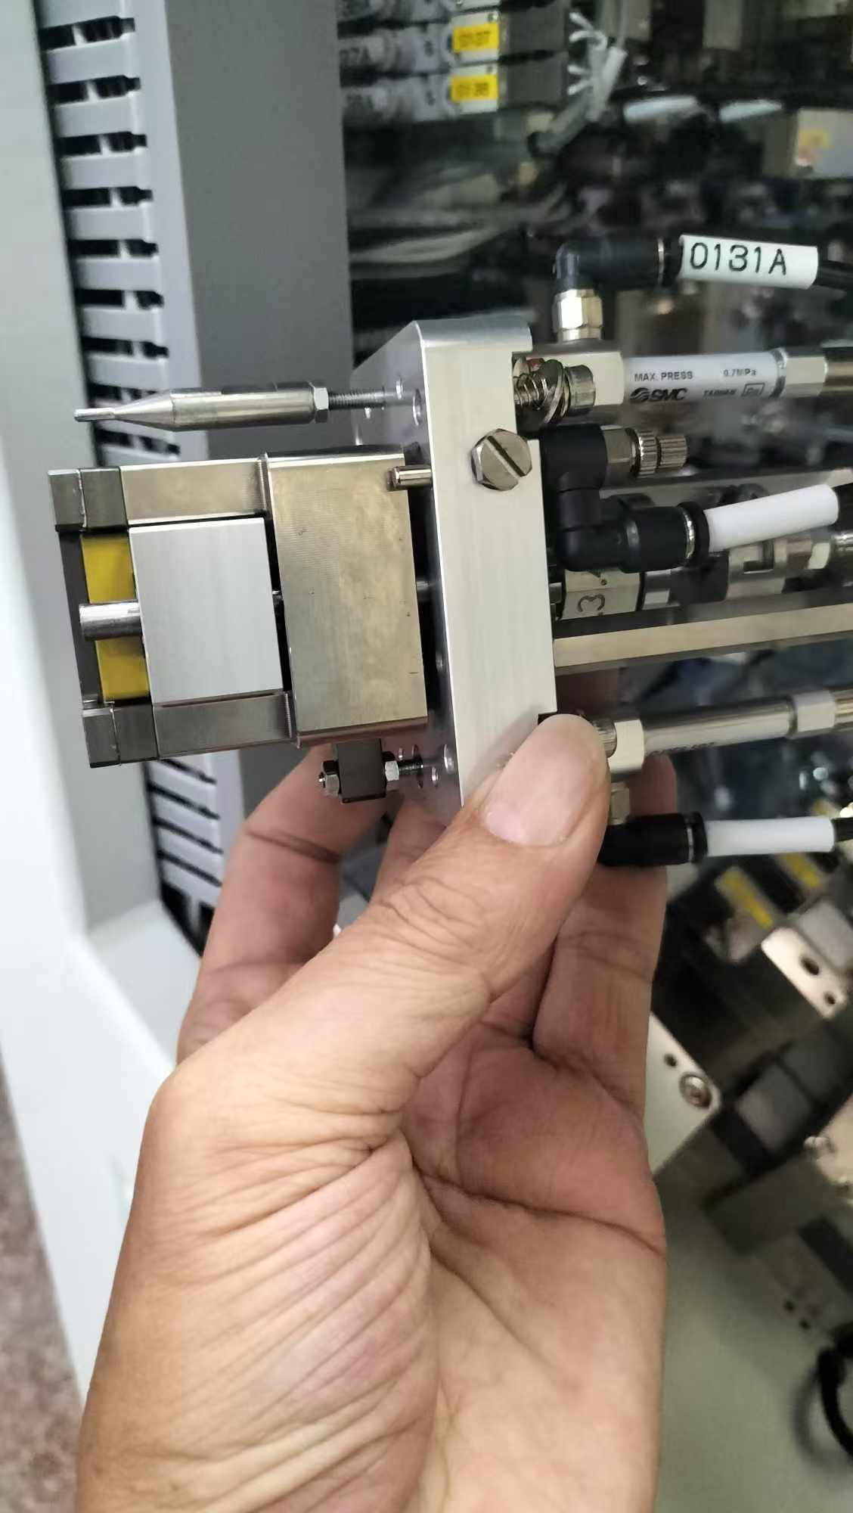
CRH220P_測試區相關
Test area related
2 Bady stop adjustment method
2 Bady stop 調整方式
未壓測時,Bady stop會先阻擋IC,
IC位置會在pin1的上方0.1mm~1mm
When not under stress testing, Bady stop will block the IC first.
The IC position will be 0.1mm~1mm above pin1
Bady stop 調整螺絲
Bady stop adjustment screw
Pin1 Location
Test area related

Slide 5
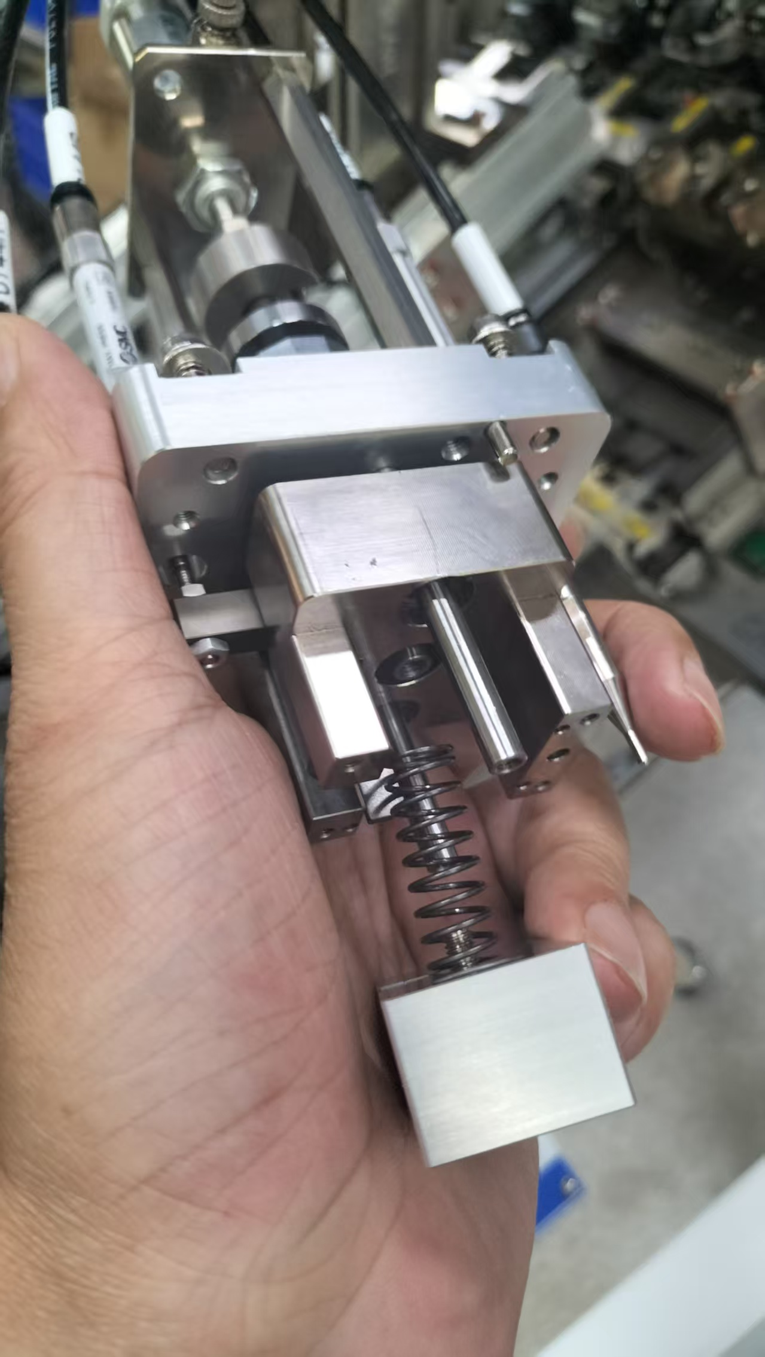
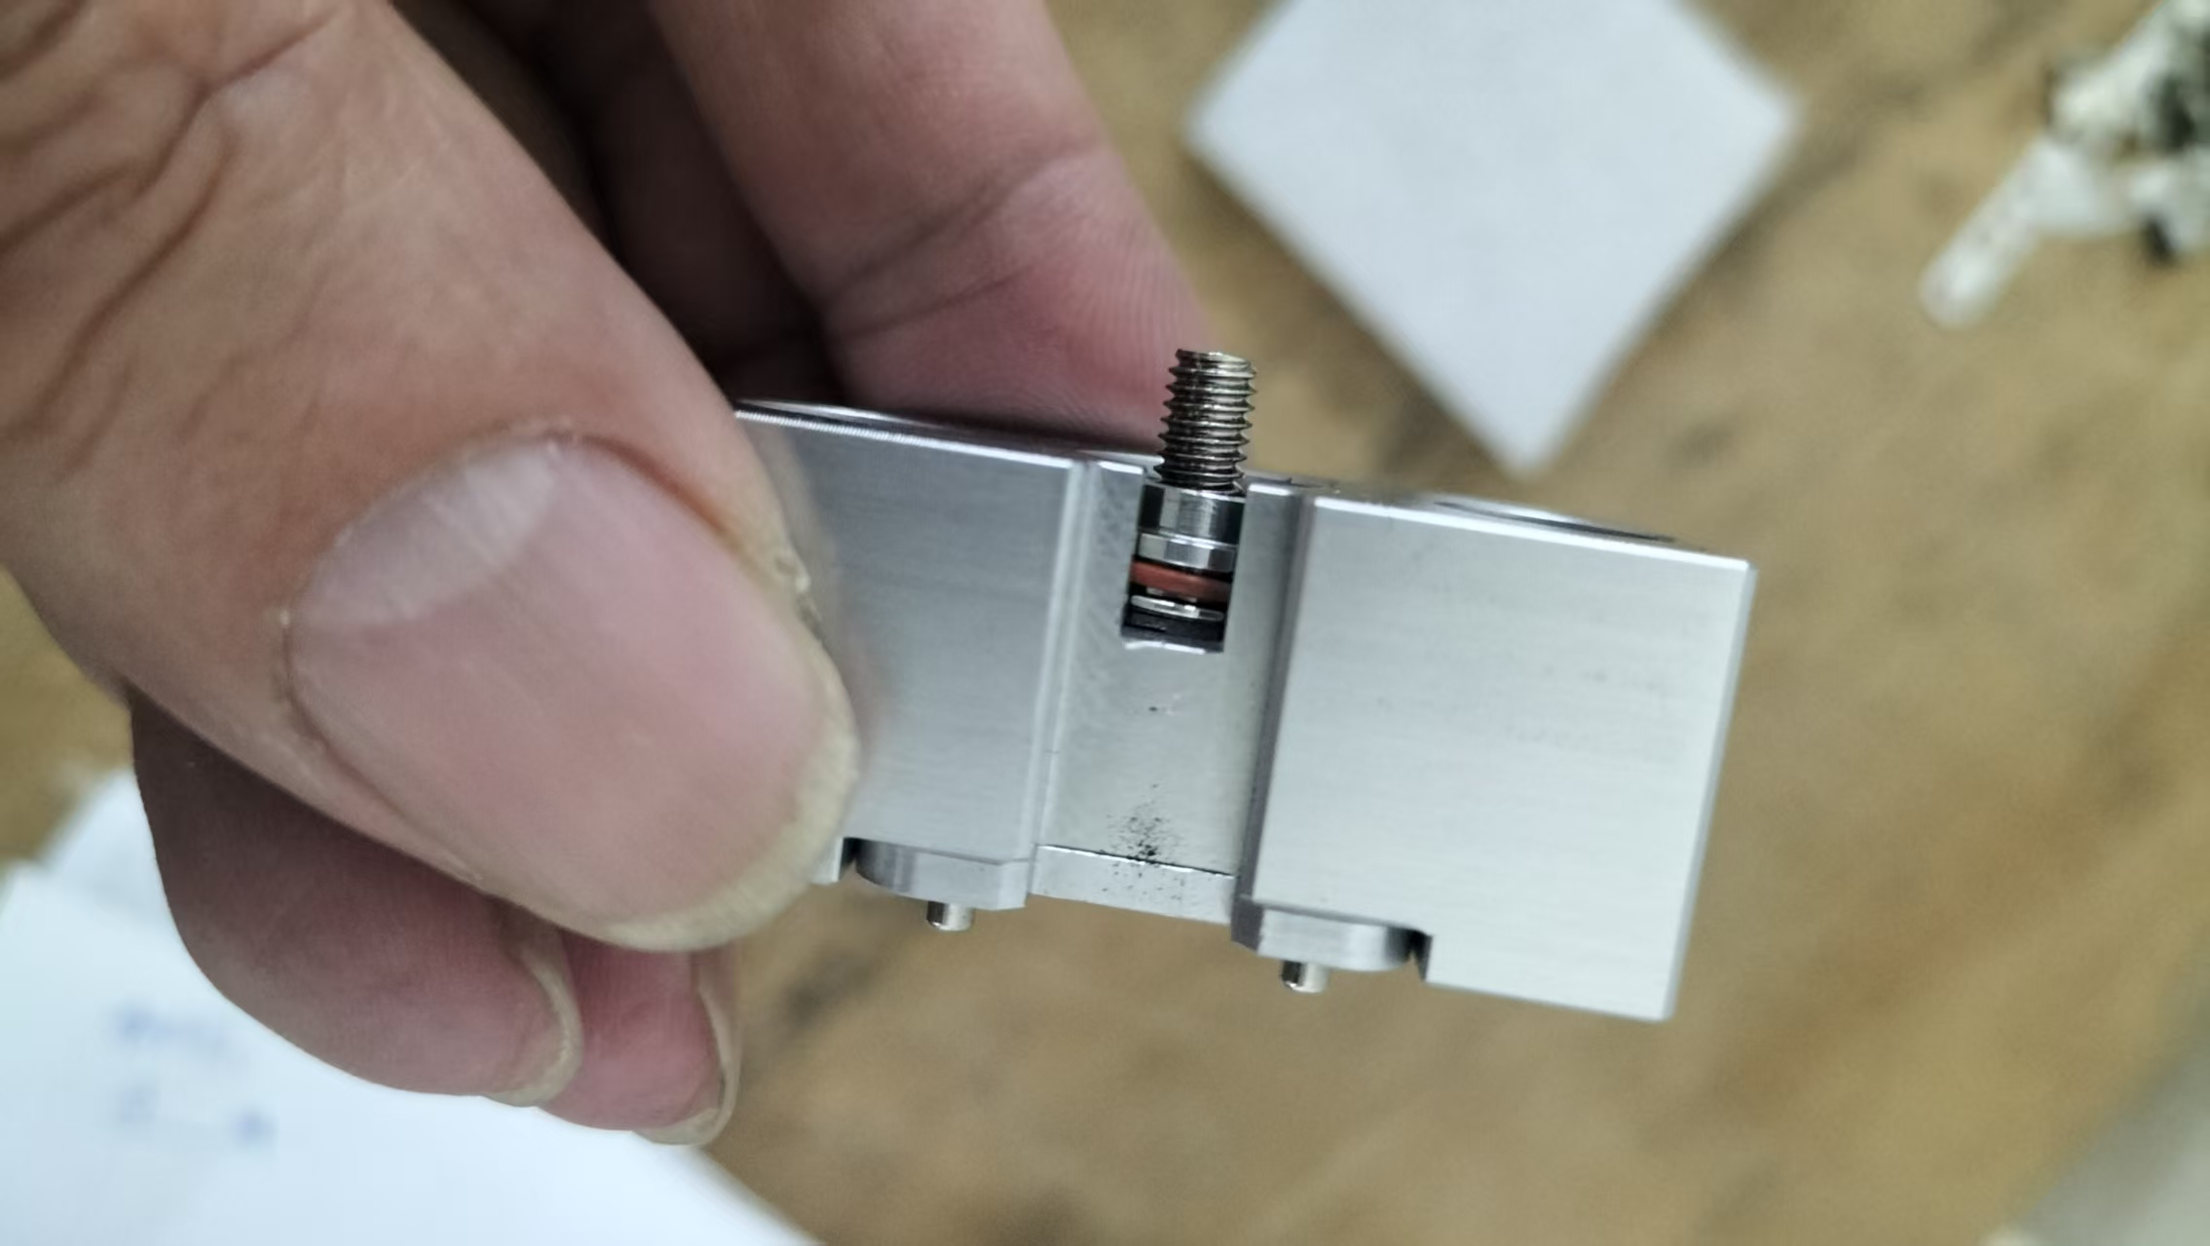
CRH220P_測試區相關
Test area related
測試區深度調整方式
1 鬆開螺絲
2 取出彈簧與測試頭
3 增加或減少墊片
Test area depth adjustment method
1 Loosen the screws
2 Take out the spring and test head
3 Add or reduce shims
Test area related

