Slide 1
CRH220P_單顆分離調整步驟
CRH220P_Feed Buffer Single separation and blocking
wenguang 2025/04/02

Slide 2
單顆分離調整步驟
Separation position adjustment steps
Separation position adjustment steps (taking the first rail as an example)
1 Turn off the air pressure
2. Block the cylinder first (O125), place an IC at the blocking position
3 Close the separation jaws (O121) and adjust the jaw position so that it touches the IC.
4 Locking disengaged position (O121)
Continue to adjust the pre-test area Double sensor (I215)
1 Release the blocking cylinder (O125) and move the IC to the pre-test area (O131)
2 Adjust the position of the sensor so that the first IC lights up (I211), the Double sensor does not light up (I215), and if two ICs are placed, it will light up (I215)
分離位置調整步驟(以第一軌為例)
1 將氣壓關閉
2 汽缸先阻擋(O125),放置一顆IC到阻擋位置
3 將分離夾爪閉合(O121),調整夾爪位置,使其碰到IC
4 鎖固分離位置(O121)
接續調整預測試區Double sensor(I215)
1 將阻擋汽缸放開(O125),讓IC到預測試區(O131)位置
2 調整SENSOR位置,讓第一顆IC亮(I211),Double sensor不亮(I215),放2顆IC則會亮(I215)
Single separation and blocking

Slide 3
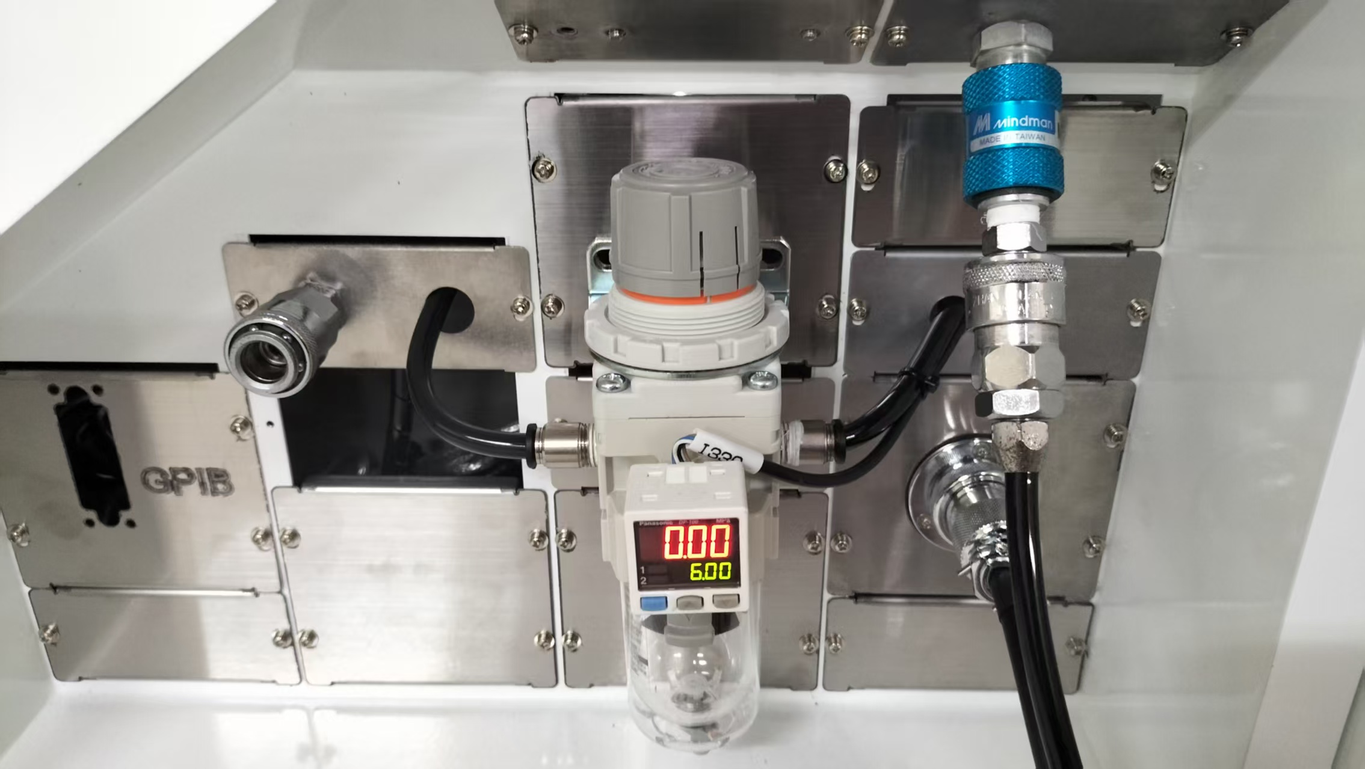
單顆分離調整步驟
Separation position adjustment steps
Separation position adjustment steps (taking the first rail as an example)
1 Turn off the air pressure
分離位置調整步驟(以第一軌為例)
1 將氣壓關閉
將藍色調整紐,往下拉,即可關閉空壓
Pull down the blue adjustment knob to turn off the air compressor.
Single separation and blocking
紅色箭頭為相對應的零件
The red arrows indicate the corresponding parts

Slide 4
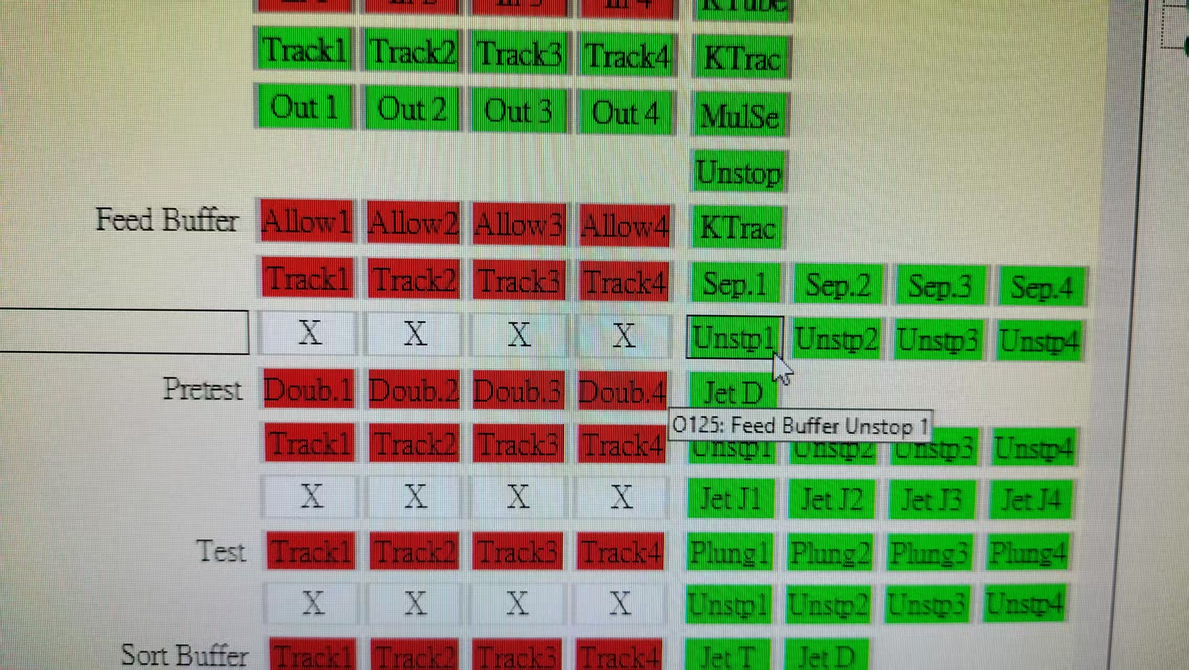
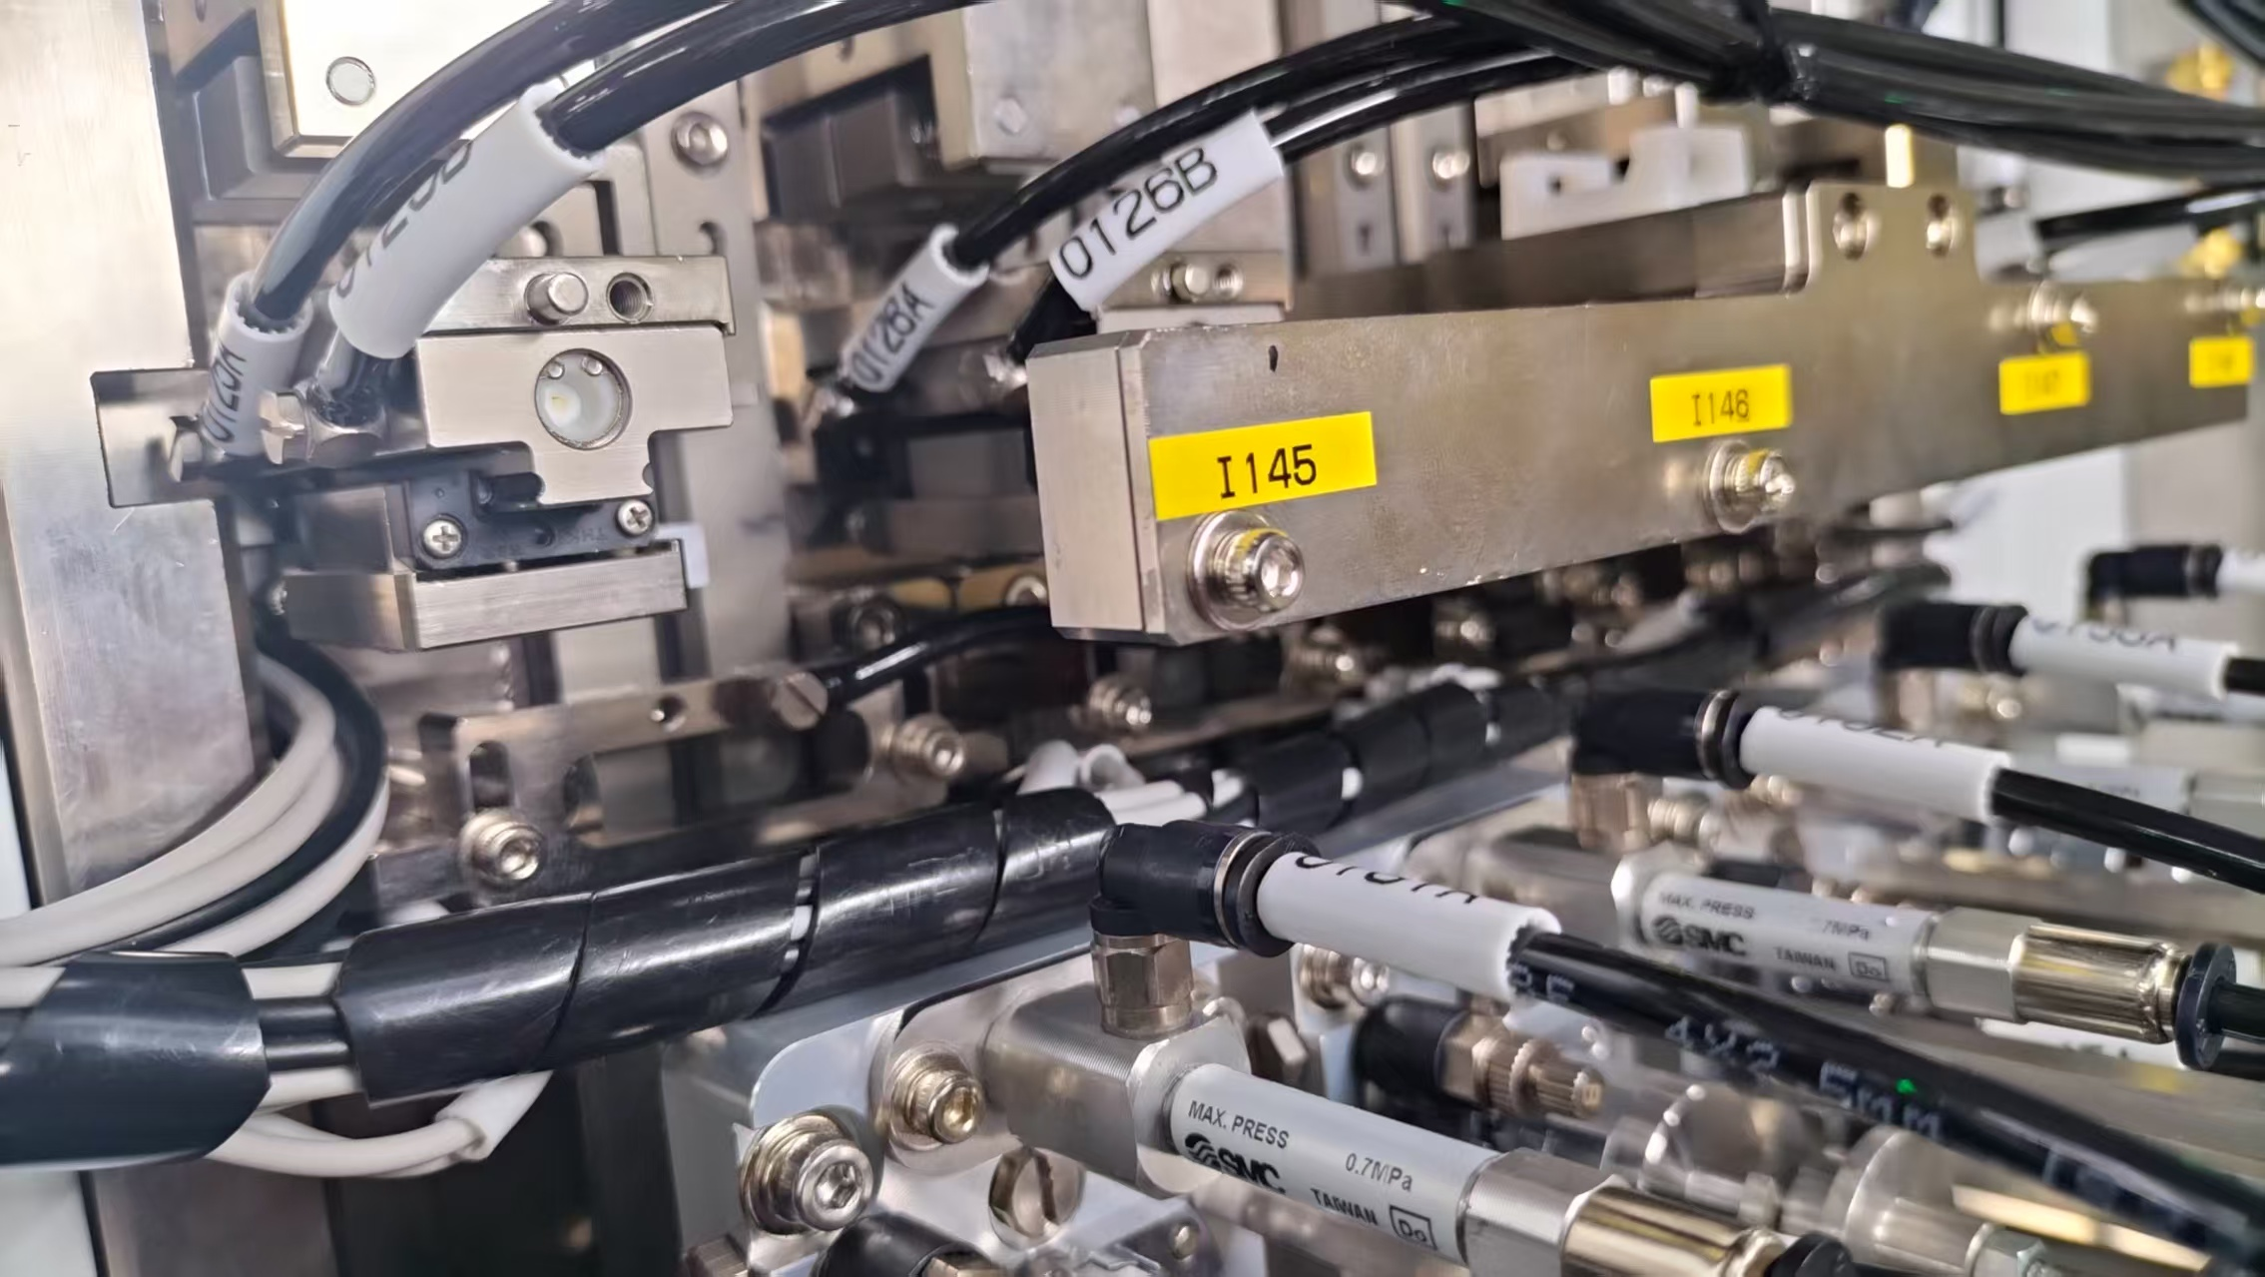
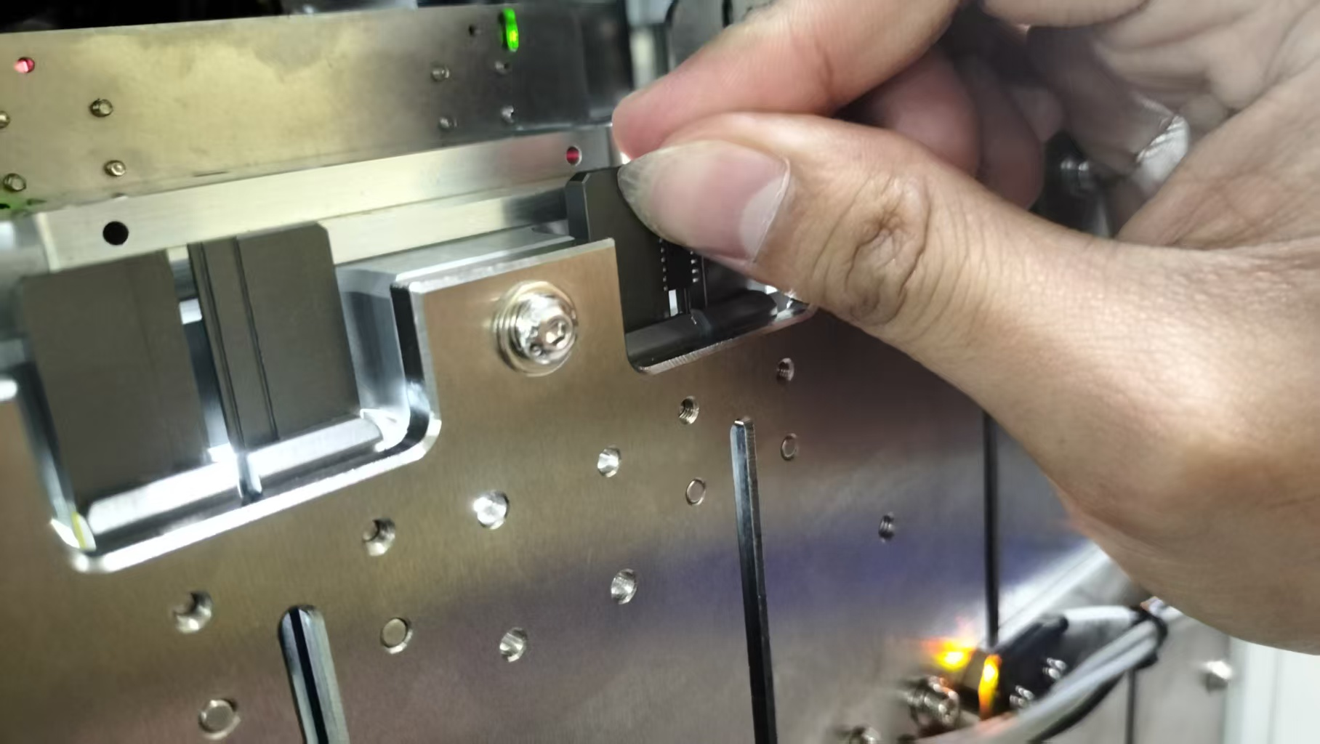
單顆分離調整步驟
Separation position adjustment steps
2 汽缸先阻擋(O125),放置一顆IC到阻擋位置
2. Block the cylinder first (O125), place an IC at the blocking position
Single separation and blocking
紅色箭頭為相對應的零件
The red arrows indicate the corresponding parts

Slide 5
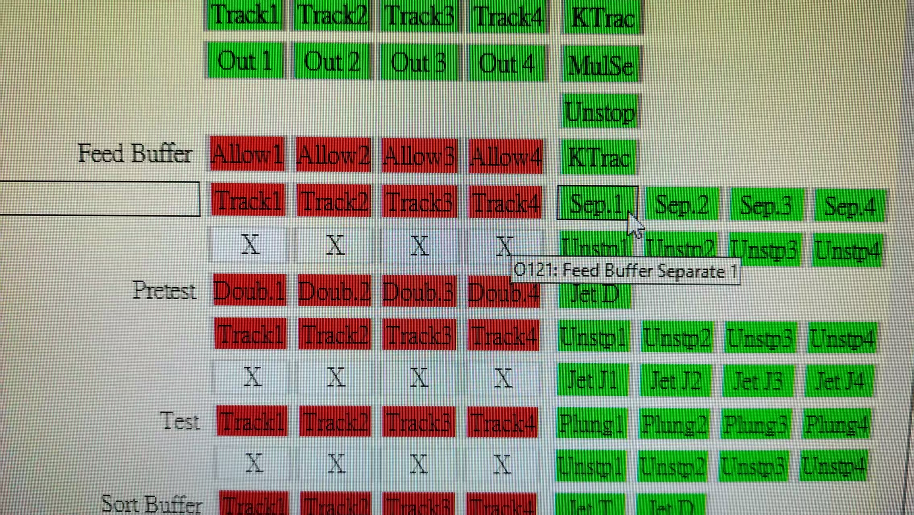
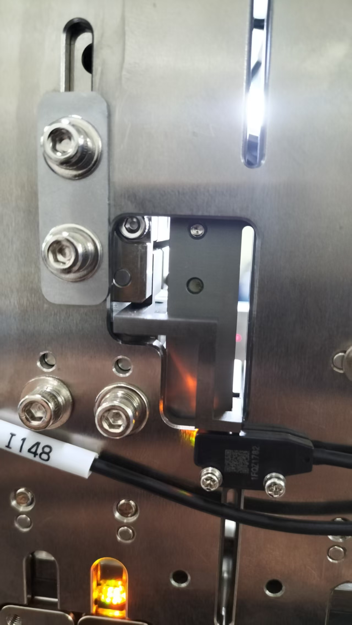
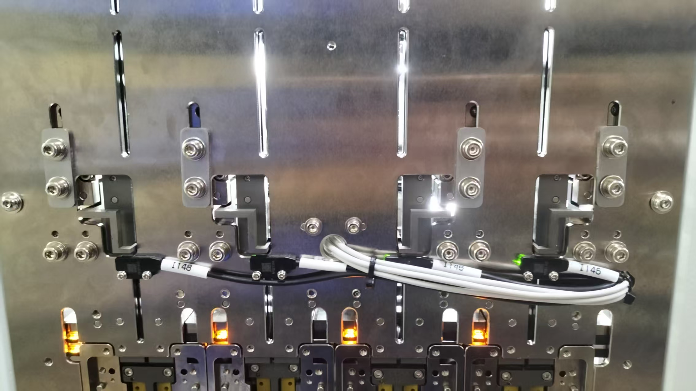
單顆分離調整步驟
Separation position adjustment steps
3 將分離夾爪閉合(O121),調整夾爪位置,使其碰到IC
3 Close the separation jaws (O121) and adjust the jaw position so that it touches the IC.
紅色箭頭為相對應的零件
The red arrows indicate the corresponding parts

Slide 6
單顆分離調整步驟
Separation position adjustment steps
4 鎖固分離位置(O121)
4 Locking disengaged position (O121)
Single separation and blocking
紅色箭頭為相對應的零件
The red arrows indicate the corresponding parts

Slide 7
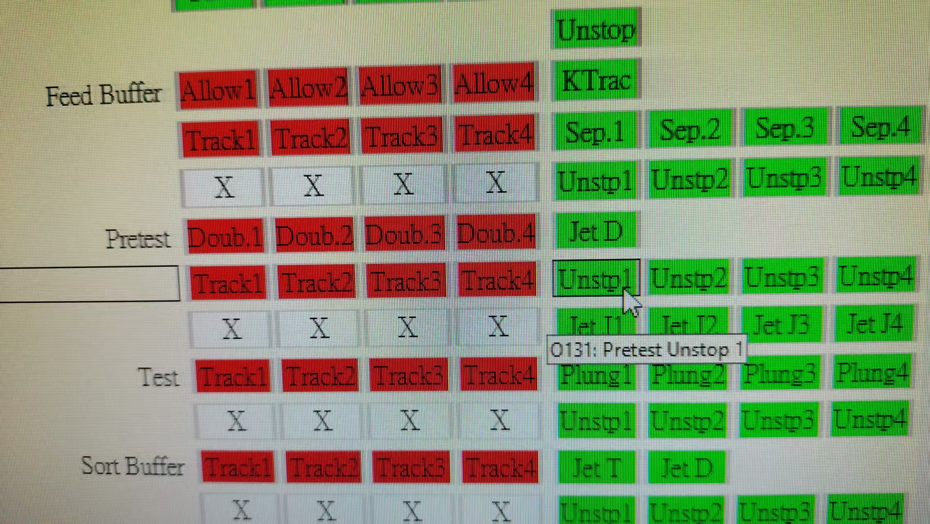
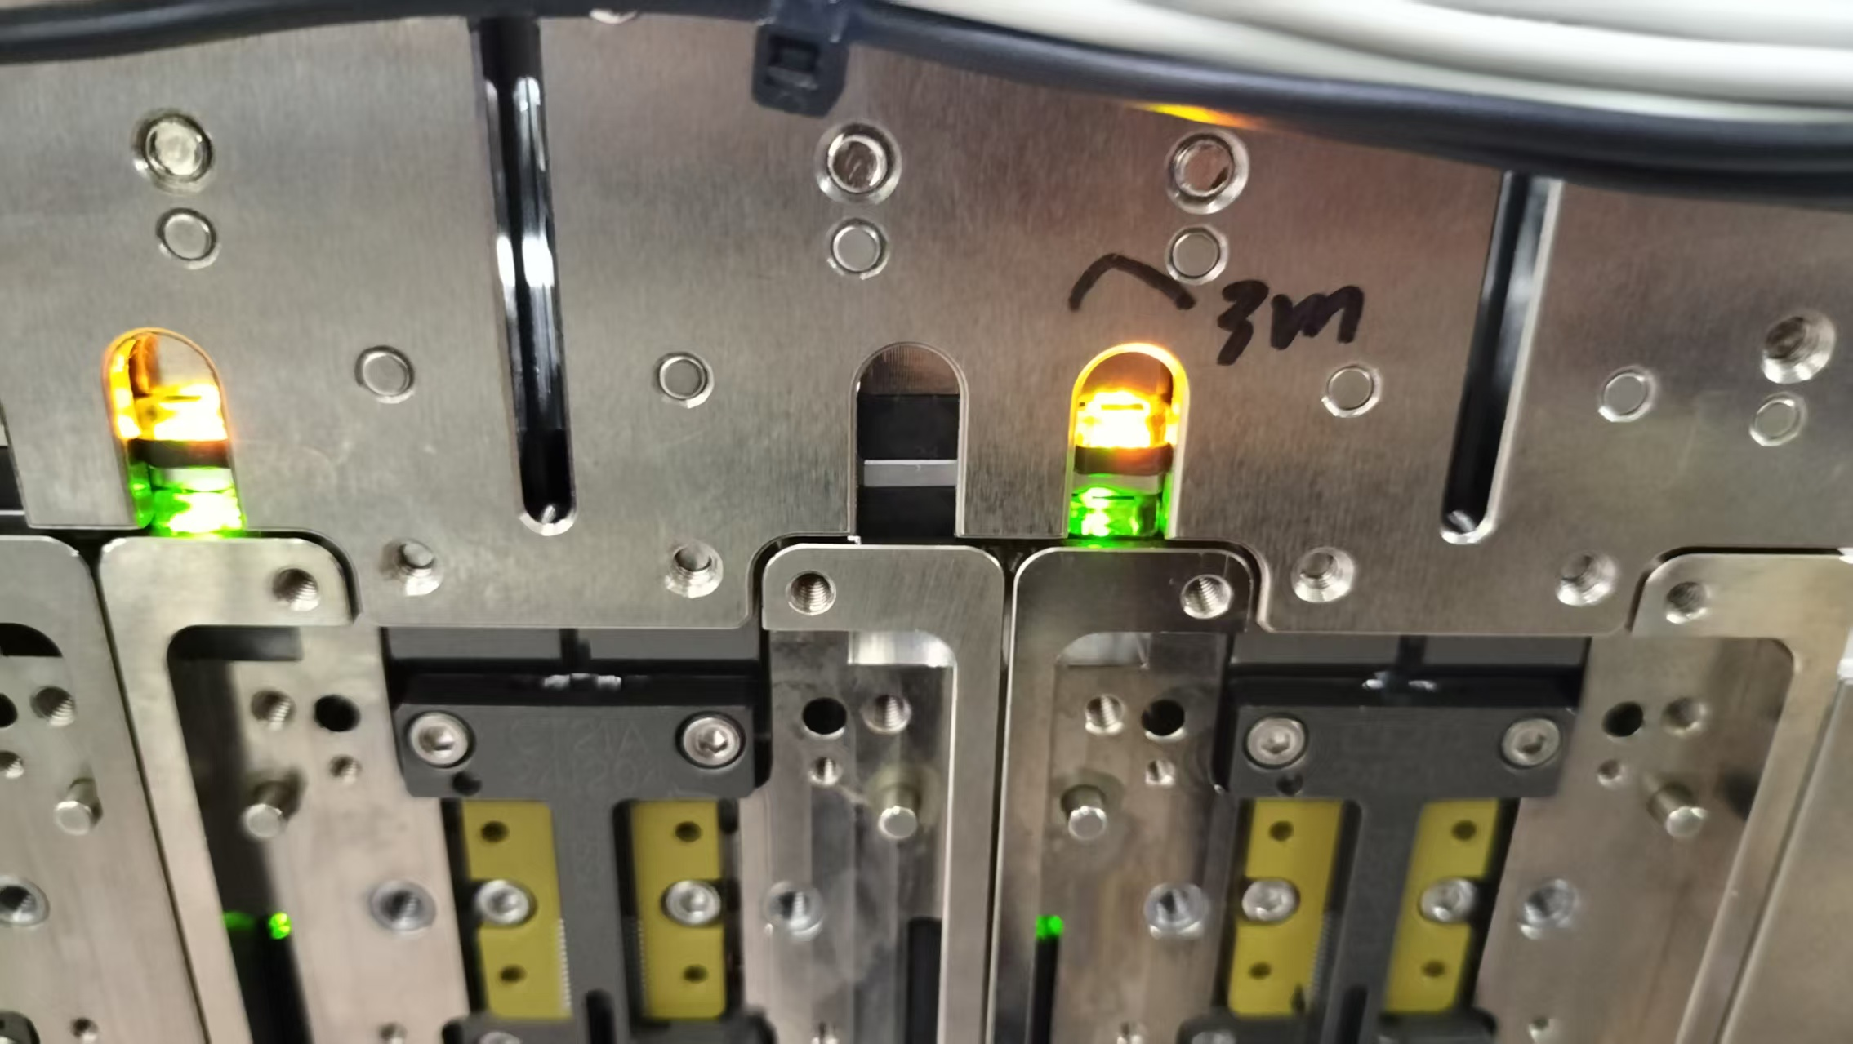
預測試區SENSOR調整步驟
Pre-test area sensor adjustment steps
接續調整預測試區Double sensor(I215)
1 將阻擋汽缸放開(O125),讓IC到預測試區(O131)位置
Continue to adjust the pre-test area Double sensor (I215)
1 Release the blocking cylinder (O125) and move the IC to the pre-test area (O131)
紅色箭頭為相對應的零件
The red arrows indicate the corresponding parts

Slide 8
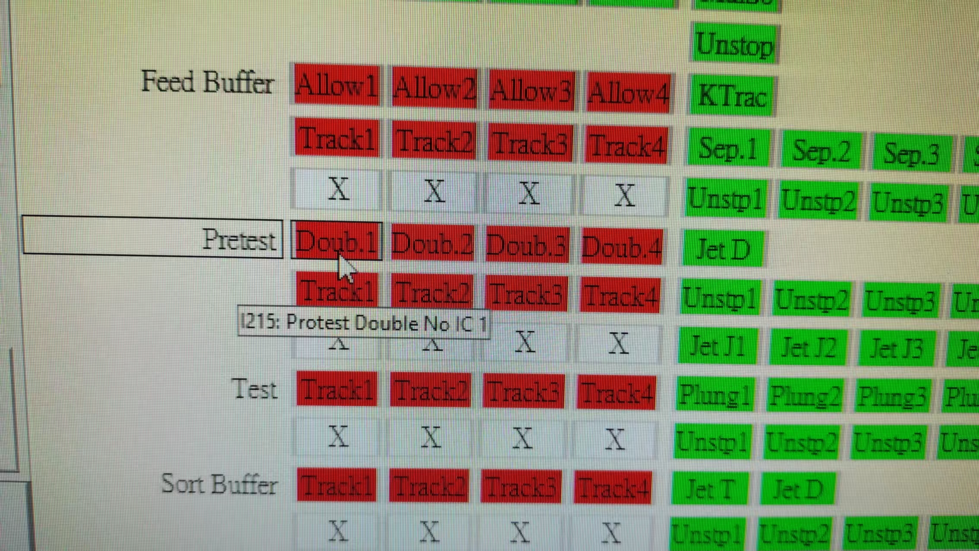
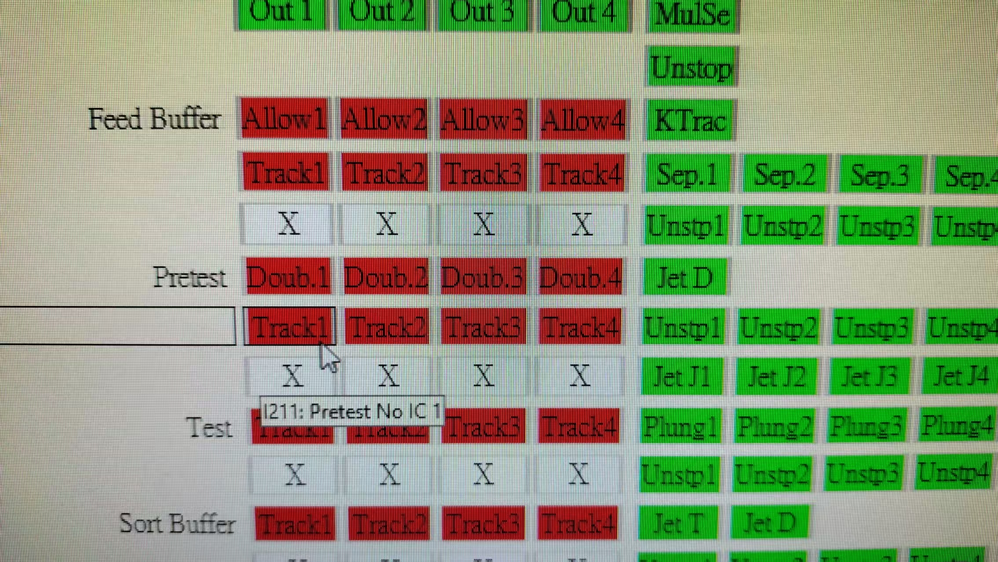
預測試區SENSOR調整步驟
Pre-test area sensor adjustment steps
2 調整SENSOR位置,讓第一顆IC亮(I211),Double sensor不亮(I215),放2顆IC則會亮(I215)
2 Adjust the position of the sensor so that the first IC lights up (I211), the Double sensor does not light up (I215), and if two ICs are placed, it will light up (I215)
綠色是偵測到IC
橘色是未偵測到IC
Green means IC is detected
Orange means no IC detected
紅色箭頭為相對應的零件
The red arrows indicate the corresponding parts

Slide 9
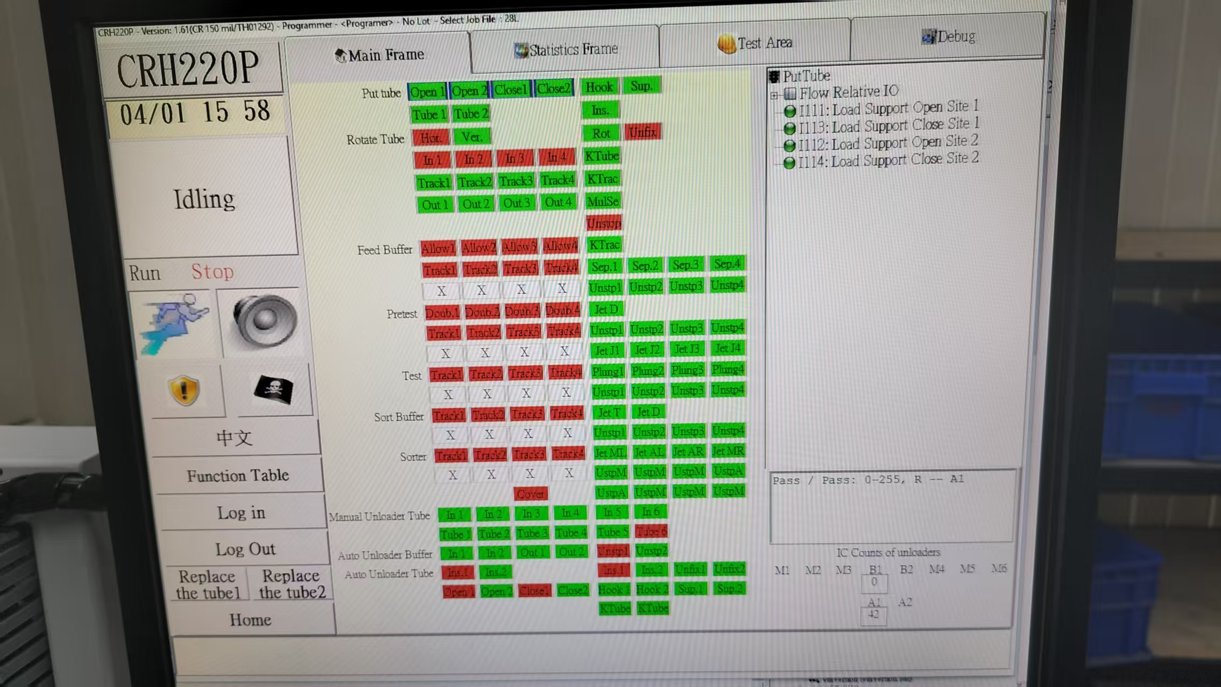
軟體英文介面
Software English interface
SOIC155 Change to SOIC296

