Slide 1
CRH220P_出料調整步驟
CRH220P_Unloader tube adjustment steps
wenguang 2025/04/07

Slide 2
出料調整步驟
Unloader tube adjustment steps
1 Place a tube and let the tube clamp (O231) clamp it. Place an IC in the automatic discharge buffer so that the IC can slide smoothly onto the tube. If it cannot slide onto the tube, adjust the height so that it can slide down smoothly.
2 Place a tube and adjust the length and width of the tube.
3 When the cannula (O227) is extended, it should be extended to the automatic discharge buffer, and it should be confirmed that it can operate normally when extended and retracted (i243)
4 Put a tube (the support tube (O223) must be supported), adjust the sensor (i317, i241) to see if there is a tube, it will light up if there is no tube, and it will not light up if there is no tube.
5 When placing two tubes, hook the second tube with the hook tube (O225). When the support tube (O223) is not supported, release the first tube, and the SENSOR (I317, I241) will not light up.
出料位置調整步驟(以第一軌為例)
1放一支管子,讓夾管(O231)夾住,在自動出料緩衝區放一顆IC,讓IC可以順利滑到管子,若無法滑到管子,則調整高度,使其順利滑下。
2放一支管子,調整管長與管寬,
3 插管(O227)伸出時,要伸到自動出料緩衝區,並確認伸出與縮回時,可正常動作(i243)
4 放一支管子(撐管(O223)要撐),調整有無料管的sensor(i317,i241),有管子則亮,無管時,則不亮
5 放二支管子時,勾管(O225)勾住第二管,當撐管(O223)不撐時,放掉第一管,則SENSOR(I317,I241)不能亮。
Unloader tube adjustment steps

Slide 3
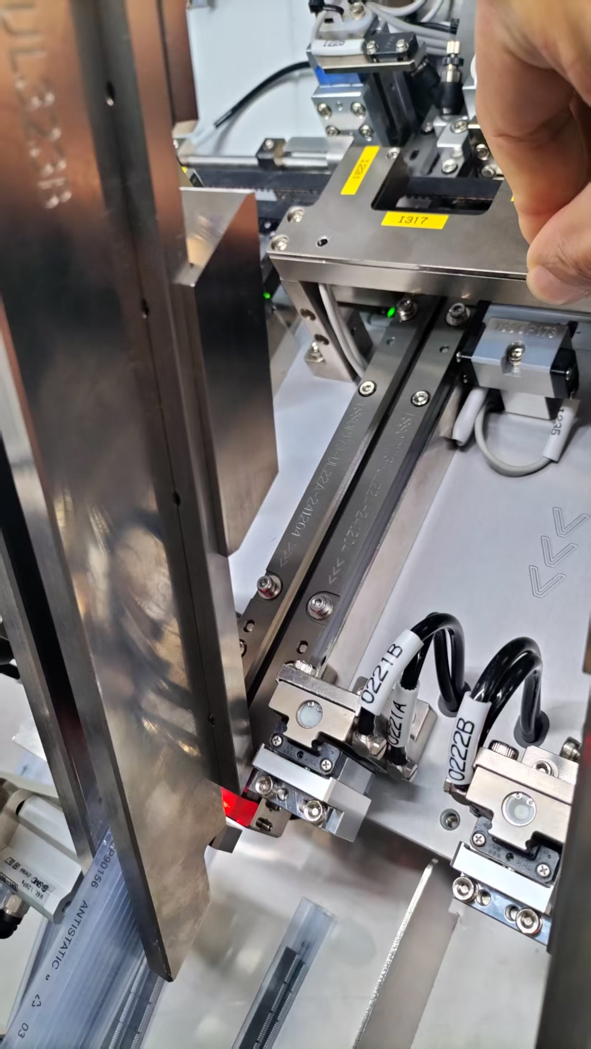
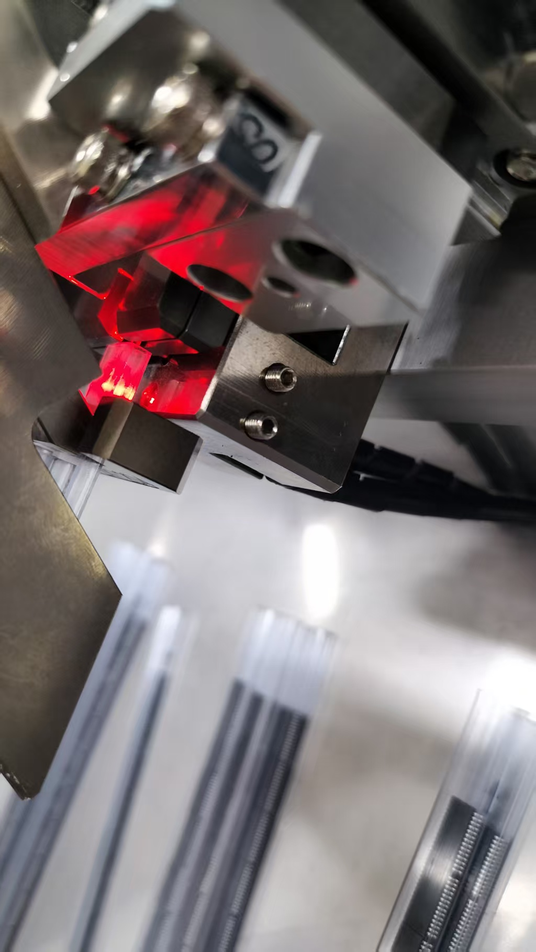
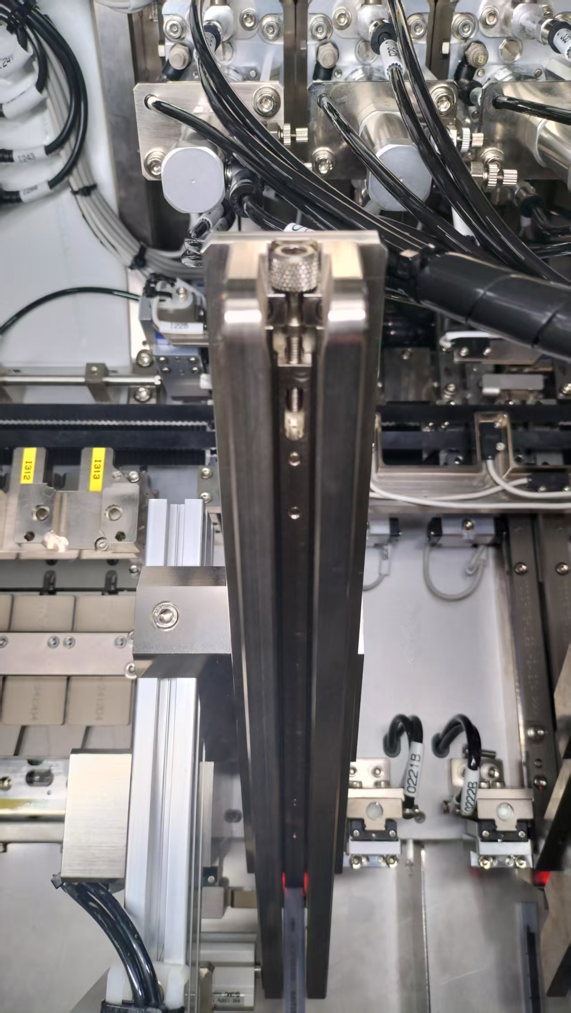
出料調整步驟
Unloader tube adjustment steps
出料位置調整步驟(以第一軌為例)
1放一支管子,讓夾管(O231)夾住,在自動出料緩衝區放一顆IC,讓IC可以順利滑到管子,若無法滑到管子,則調整高度,使其順利滑下。
Take the first track as an example
1 Place a tube and let the tube clamp (O231) clamp it. Place an IC in the automatic discharge buffer so that the IC can slide smoothly onto the tube. If it cannot slide onto the tube, adjust the height so that it can slide down smoothly.

Slide 4
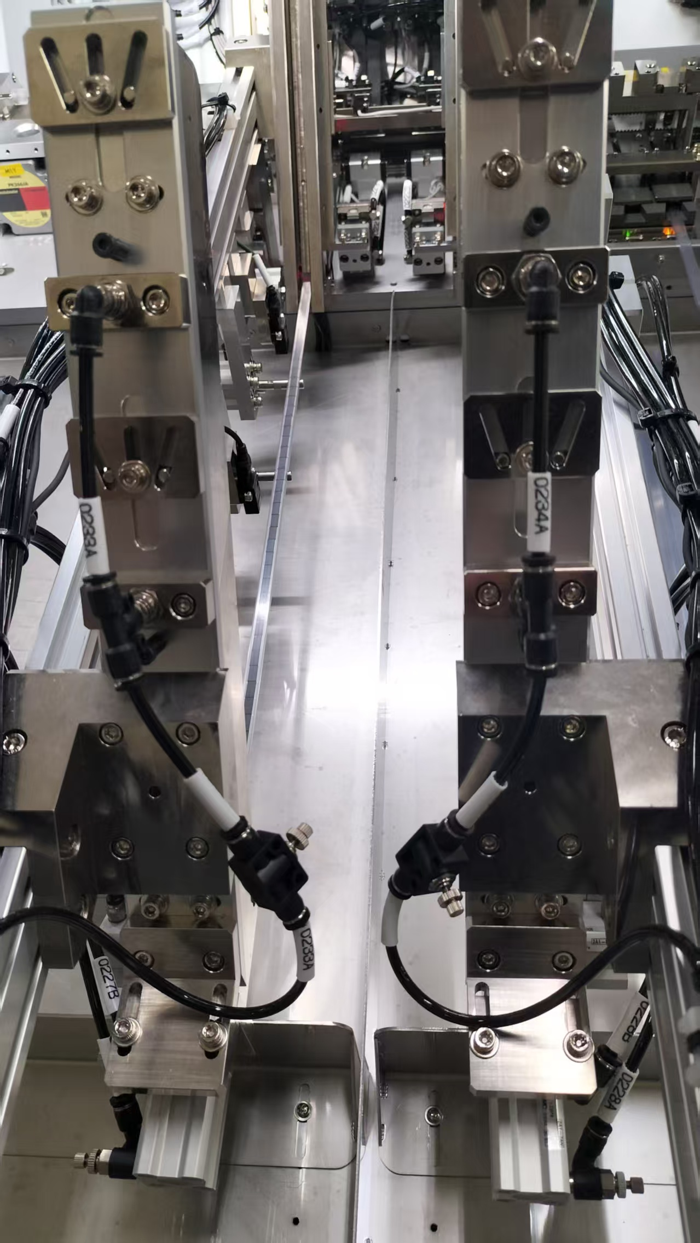
出料調整步驟
Unloader tube adjustment steps
2放一支管子,調整管長與管寬,
2 Place a tube and adjust the length and width of the tube.
Unloader tube adjustment steps

Slide 5
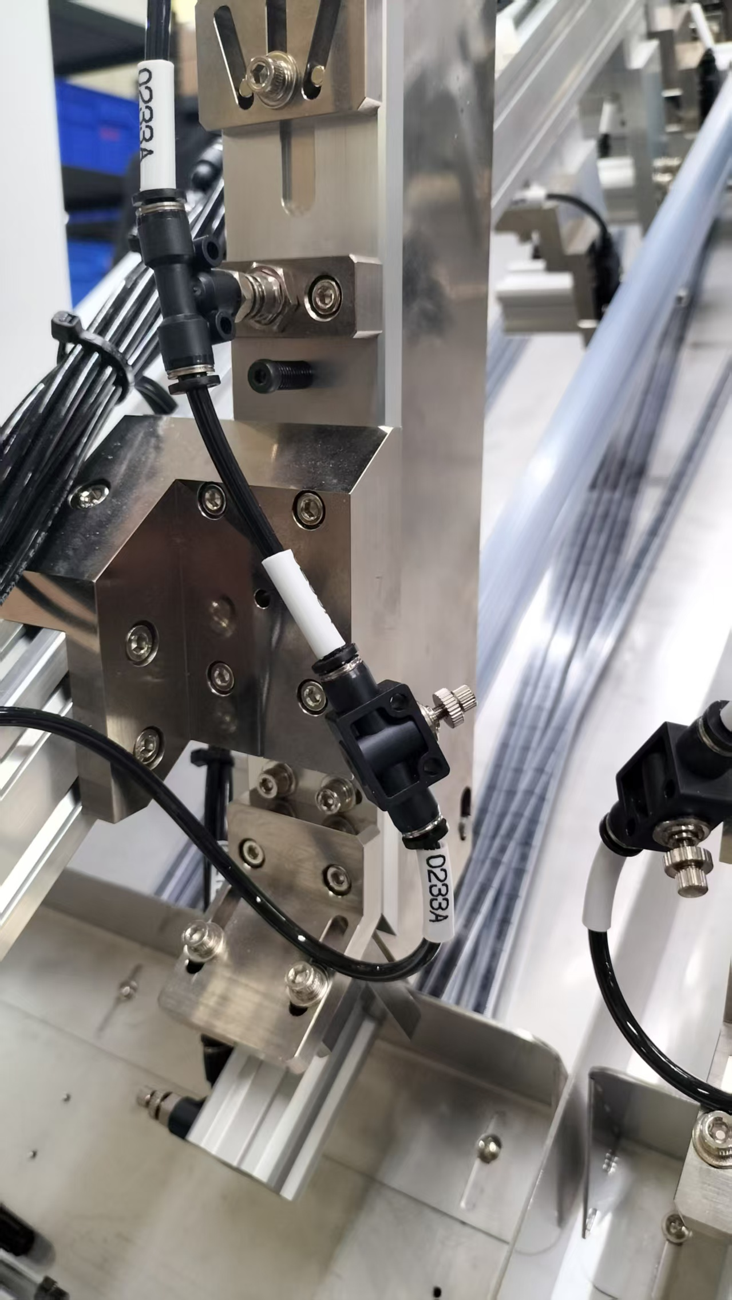
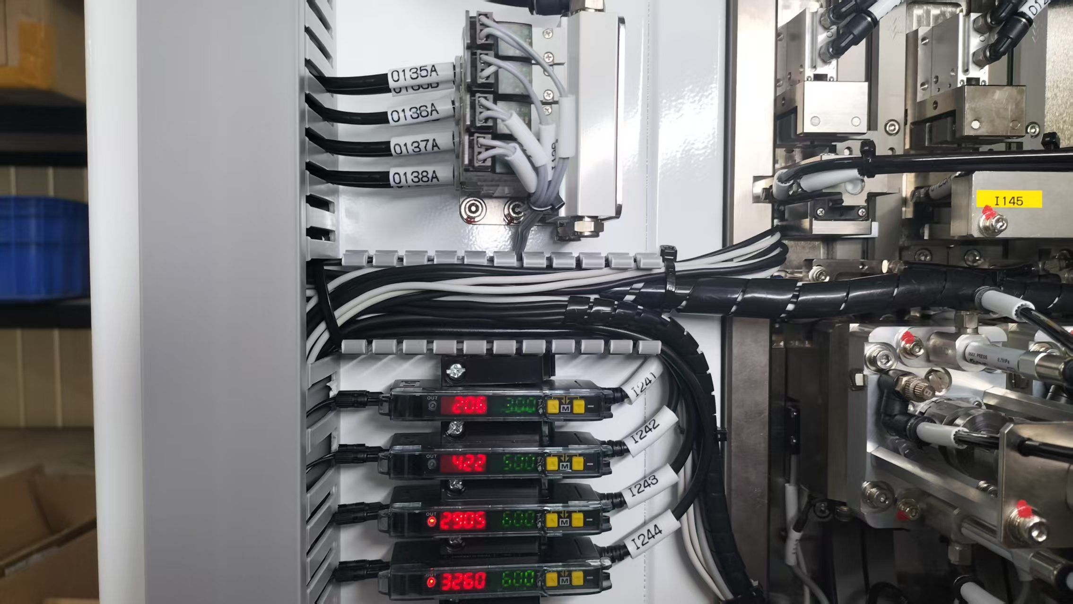
出料調整步驟
Unloader tube adjustment steps
3 插管(O227)伸出時,要伸到自動出料緩衝區,並確認伸出與縮回時,可正常動作(i243)
3 When the cannula (O227) is extended, it should be extended to the automatic discharge buffer, and it should be confirmed that it can operate normally when extended and retracted (i243)
Unloader tube adjustment steps

Slide 6
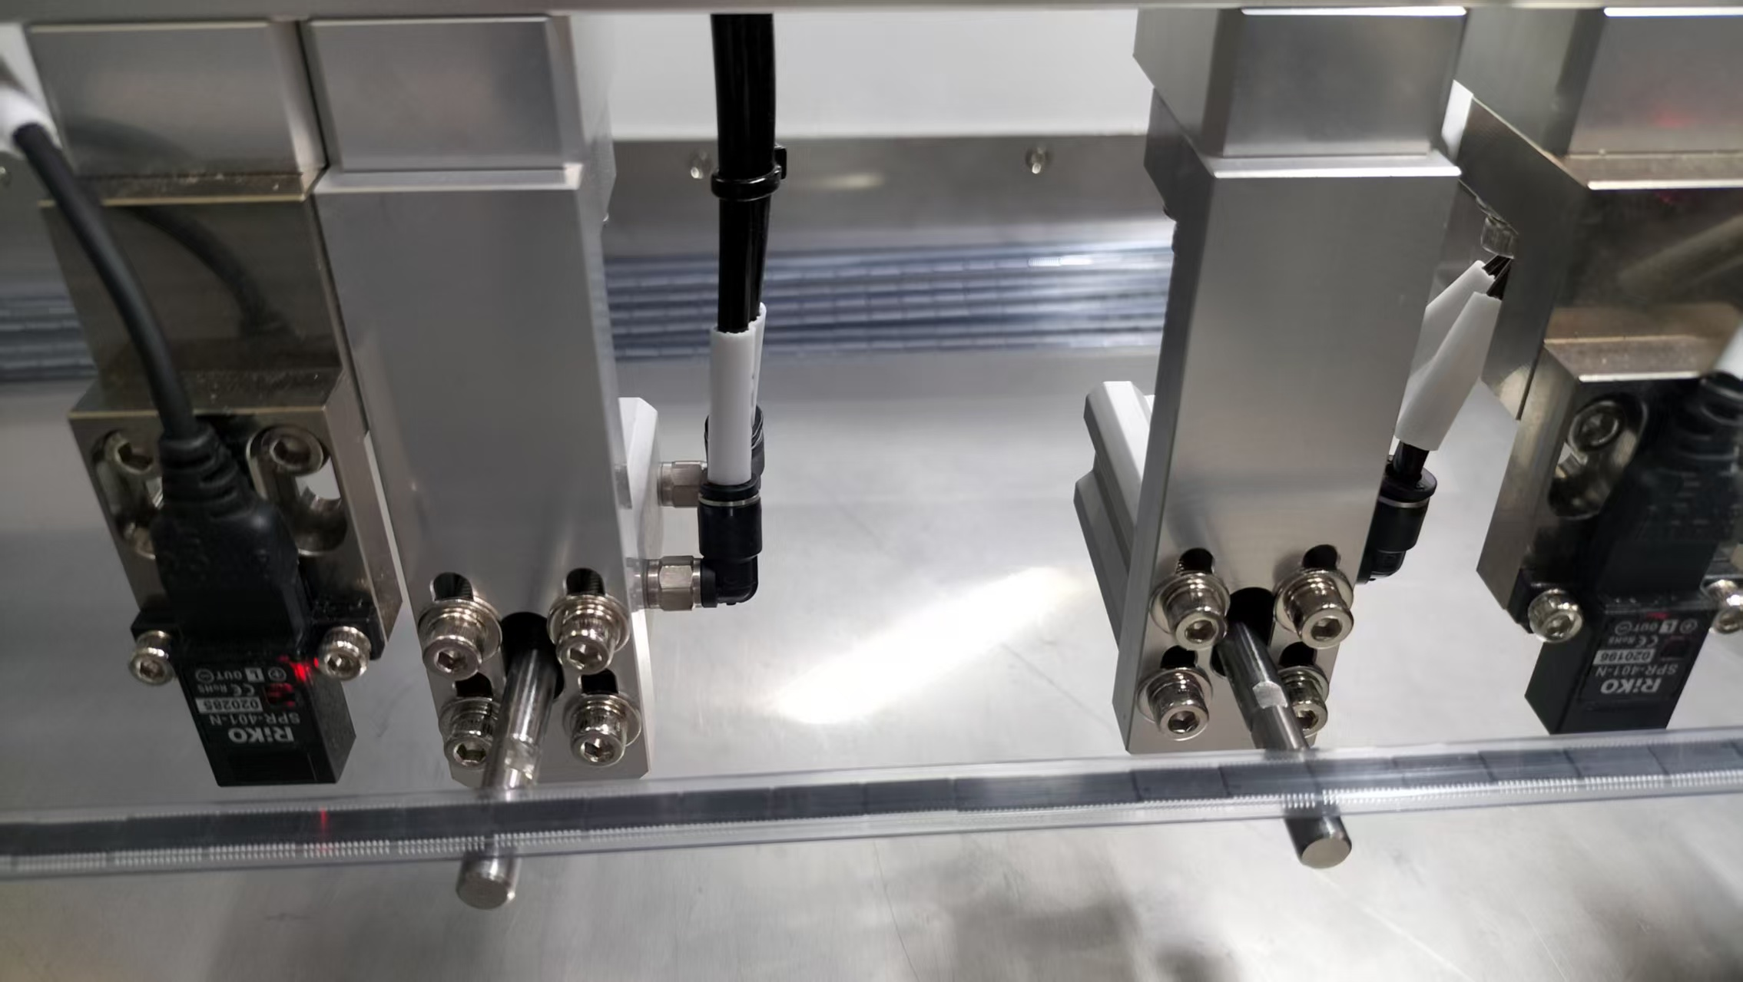
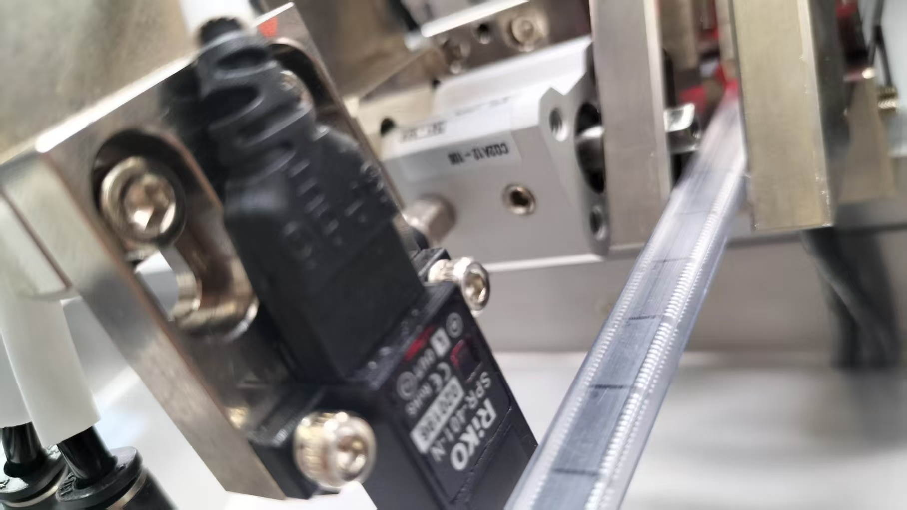
出料調整步驟
Unloader tube adjustment steps
4 Put a tube (the support tube (O223) must be supported), adjust the sensor (i317, i241) to see if there is a tube, it will light up if there is no tube, and it will not light up if there is no tube.
4 放一支管子(撐管(O223)要撐),調整有無料管的sensor(i317,i241),有管子則亮,無管時,則不亮
Unloader tube adjustment steps

Slide 7
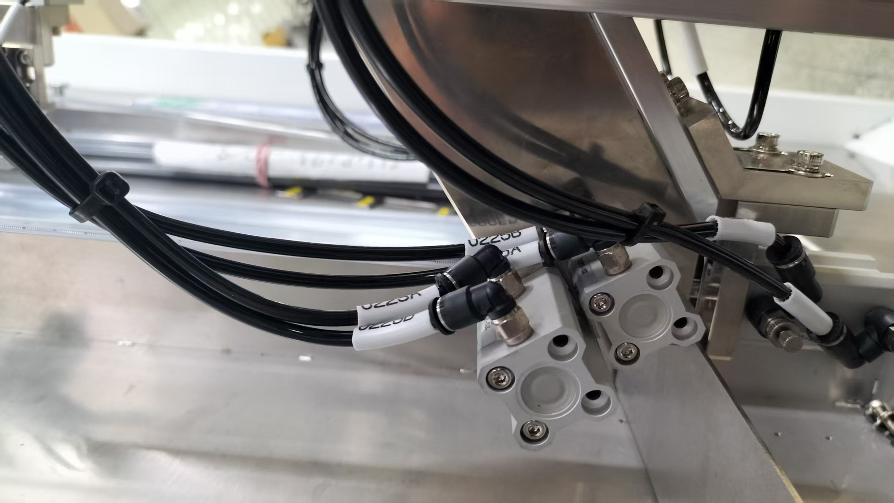
出料調整步驟
Unloader tube adjustment steps
5 放二支管子時,勾管(O225)勾住第二管,當撐管(O223)不撐時,放掉第一管,則SENSOR(I317,I241)不能亮。
5 When placing two tubes, hook the second tube with the hook tube (O225). When the support tube (O223) is not supported, release the first tube, and the SENSOR (I317, I241) will not light up.
Unloader tube adjustment steps

