Slide 1
CRH220P_入料調整步驟
CRH220P_Loader tube adjustment steps
wenguang 2025/04/02

Slide 2
入料調整步驟
Loader tube adjustment steps
入料位置調整步驟(以第一軌為例)
1 放一支管子,先調整管長與管寬
2放一支管子,調整有無料管的sensor,撐管向上時,sensor不亮,撐管向下時,sensor要亮
3 放二支管子時,勾管要勾住第二管,不能勾住第一管
Loader tube adjustment steps (taking the first track as an example)
1 Put a tube in place and adjust the length and width of the tube first.
2. Put a tube and adjust the sensor. When the Supporting tube is upward, the sensor is not lit. When the Supporting tube is downward, the sensor should be lit.
3 When placing two tube, the hook should be hooked on the second tube, not the first tube.
Put tube adjustment steps

Slide 3
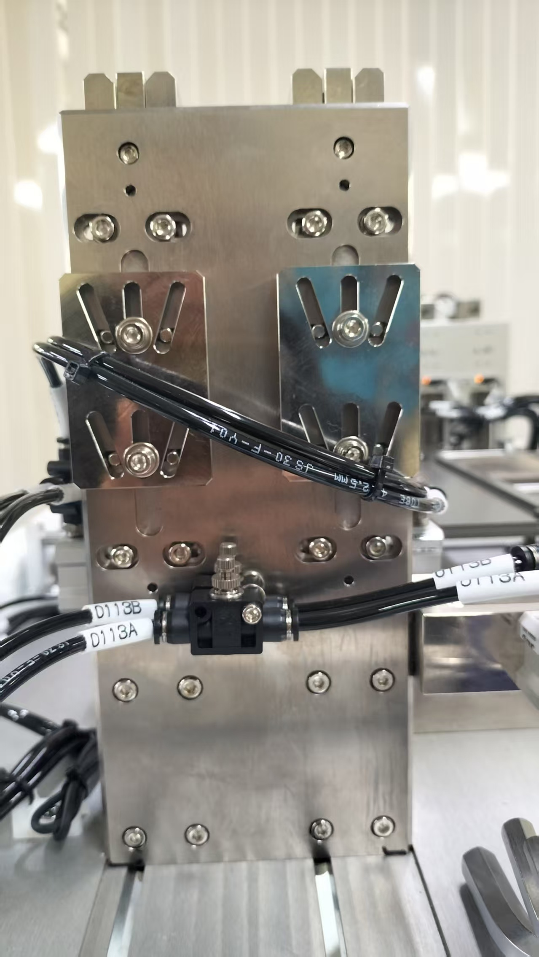
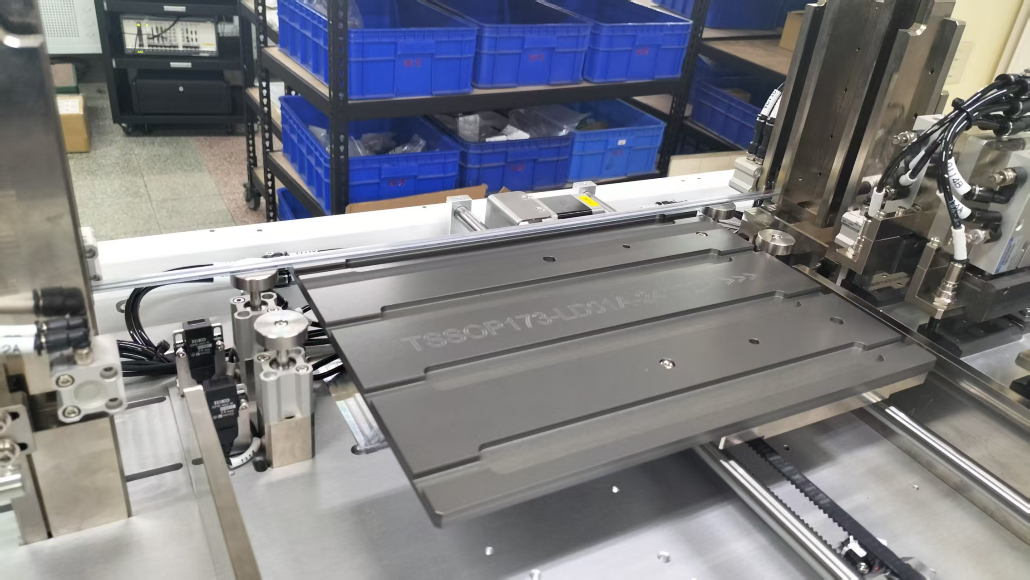
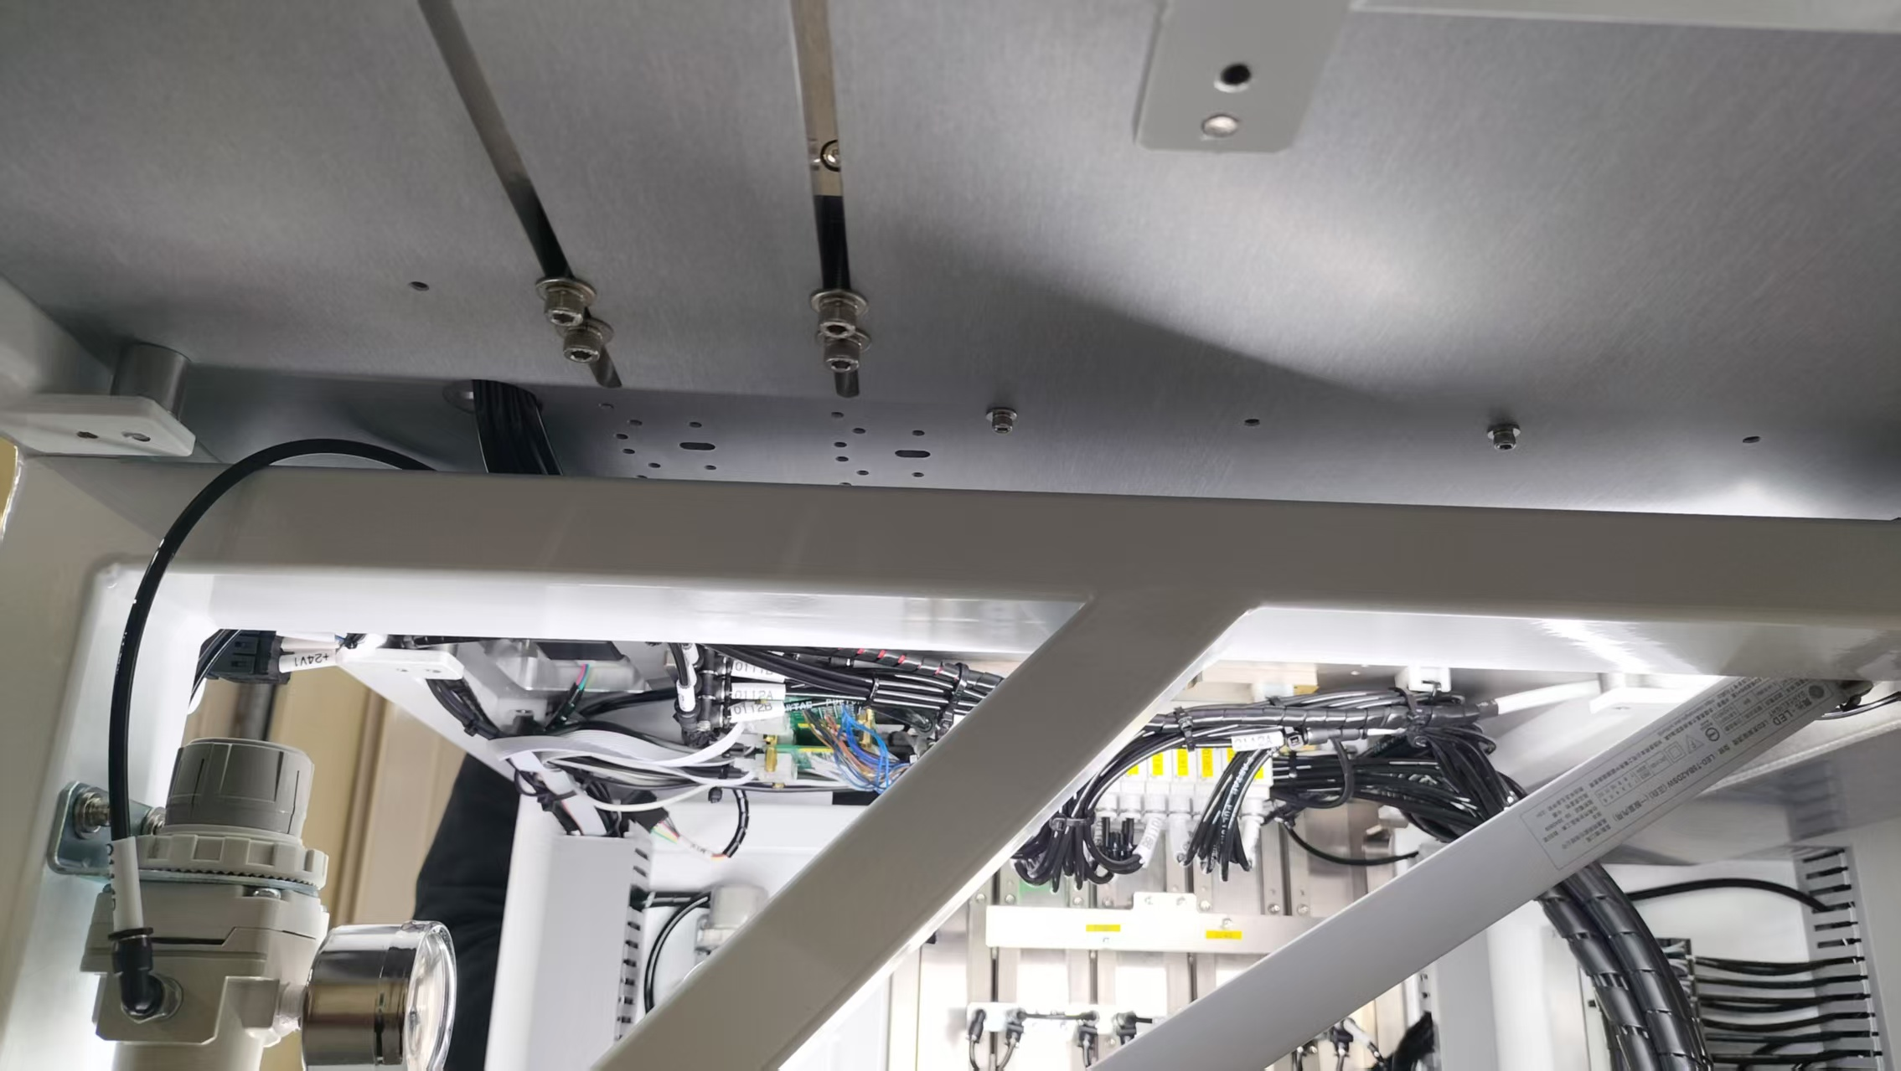
入料調整步驟
Loader tube adjustment steps
入料位置調整步驟(以第一軌為例)
1 放一支管子,先調整管長與管寬
Put tube adjustment steps (taking the first track as an example)
1 Put a tube in place and adjust the length and width of the tube first.
Put tube adjustment steps
紅色箭頭為相對應的零件
The red arrows indicate the corresponding parts

Slide 4
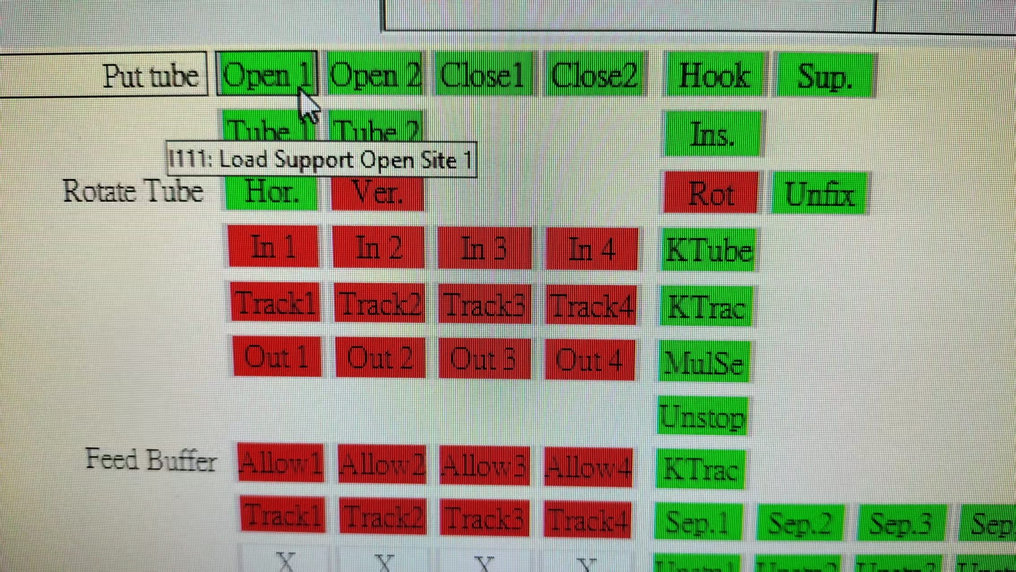
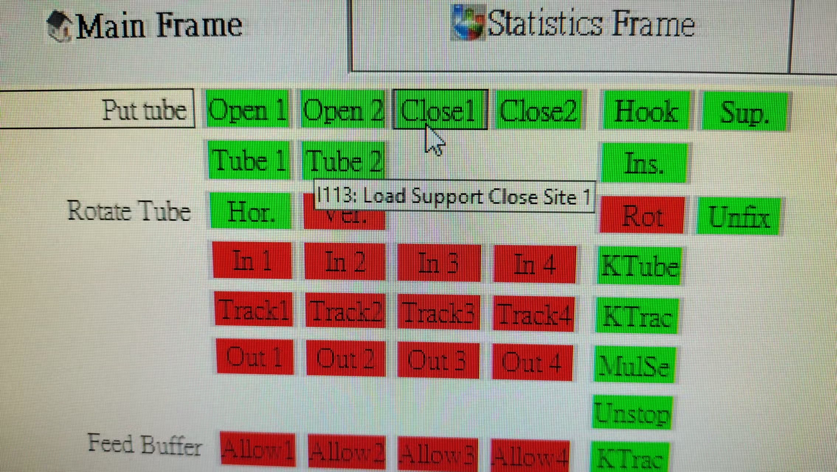
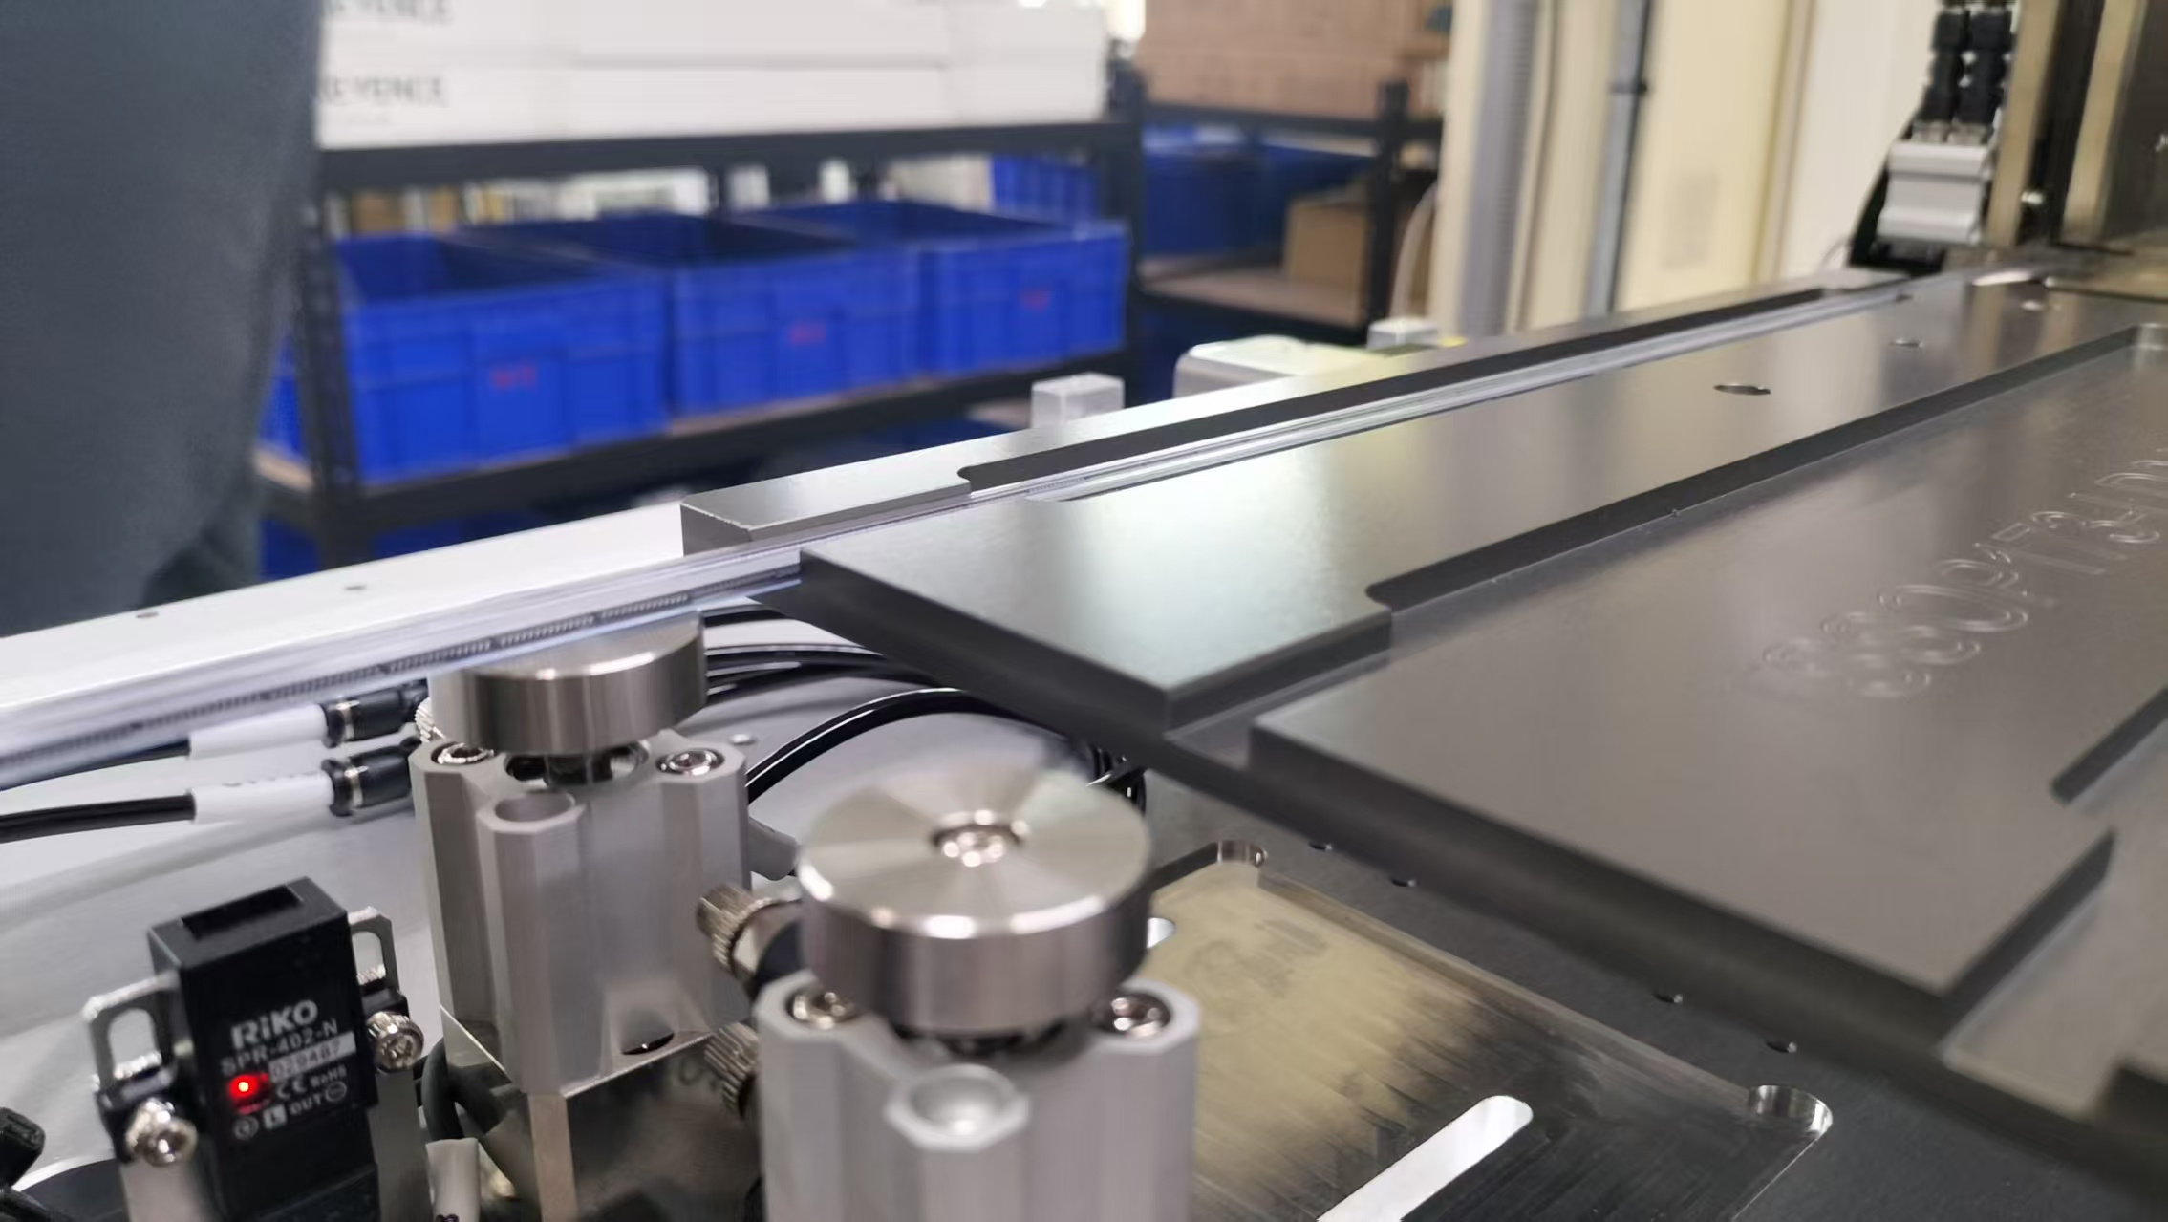
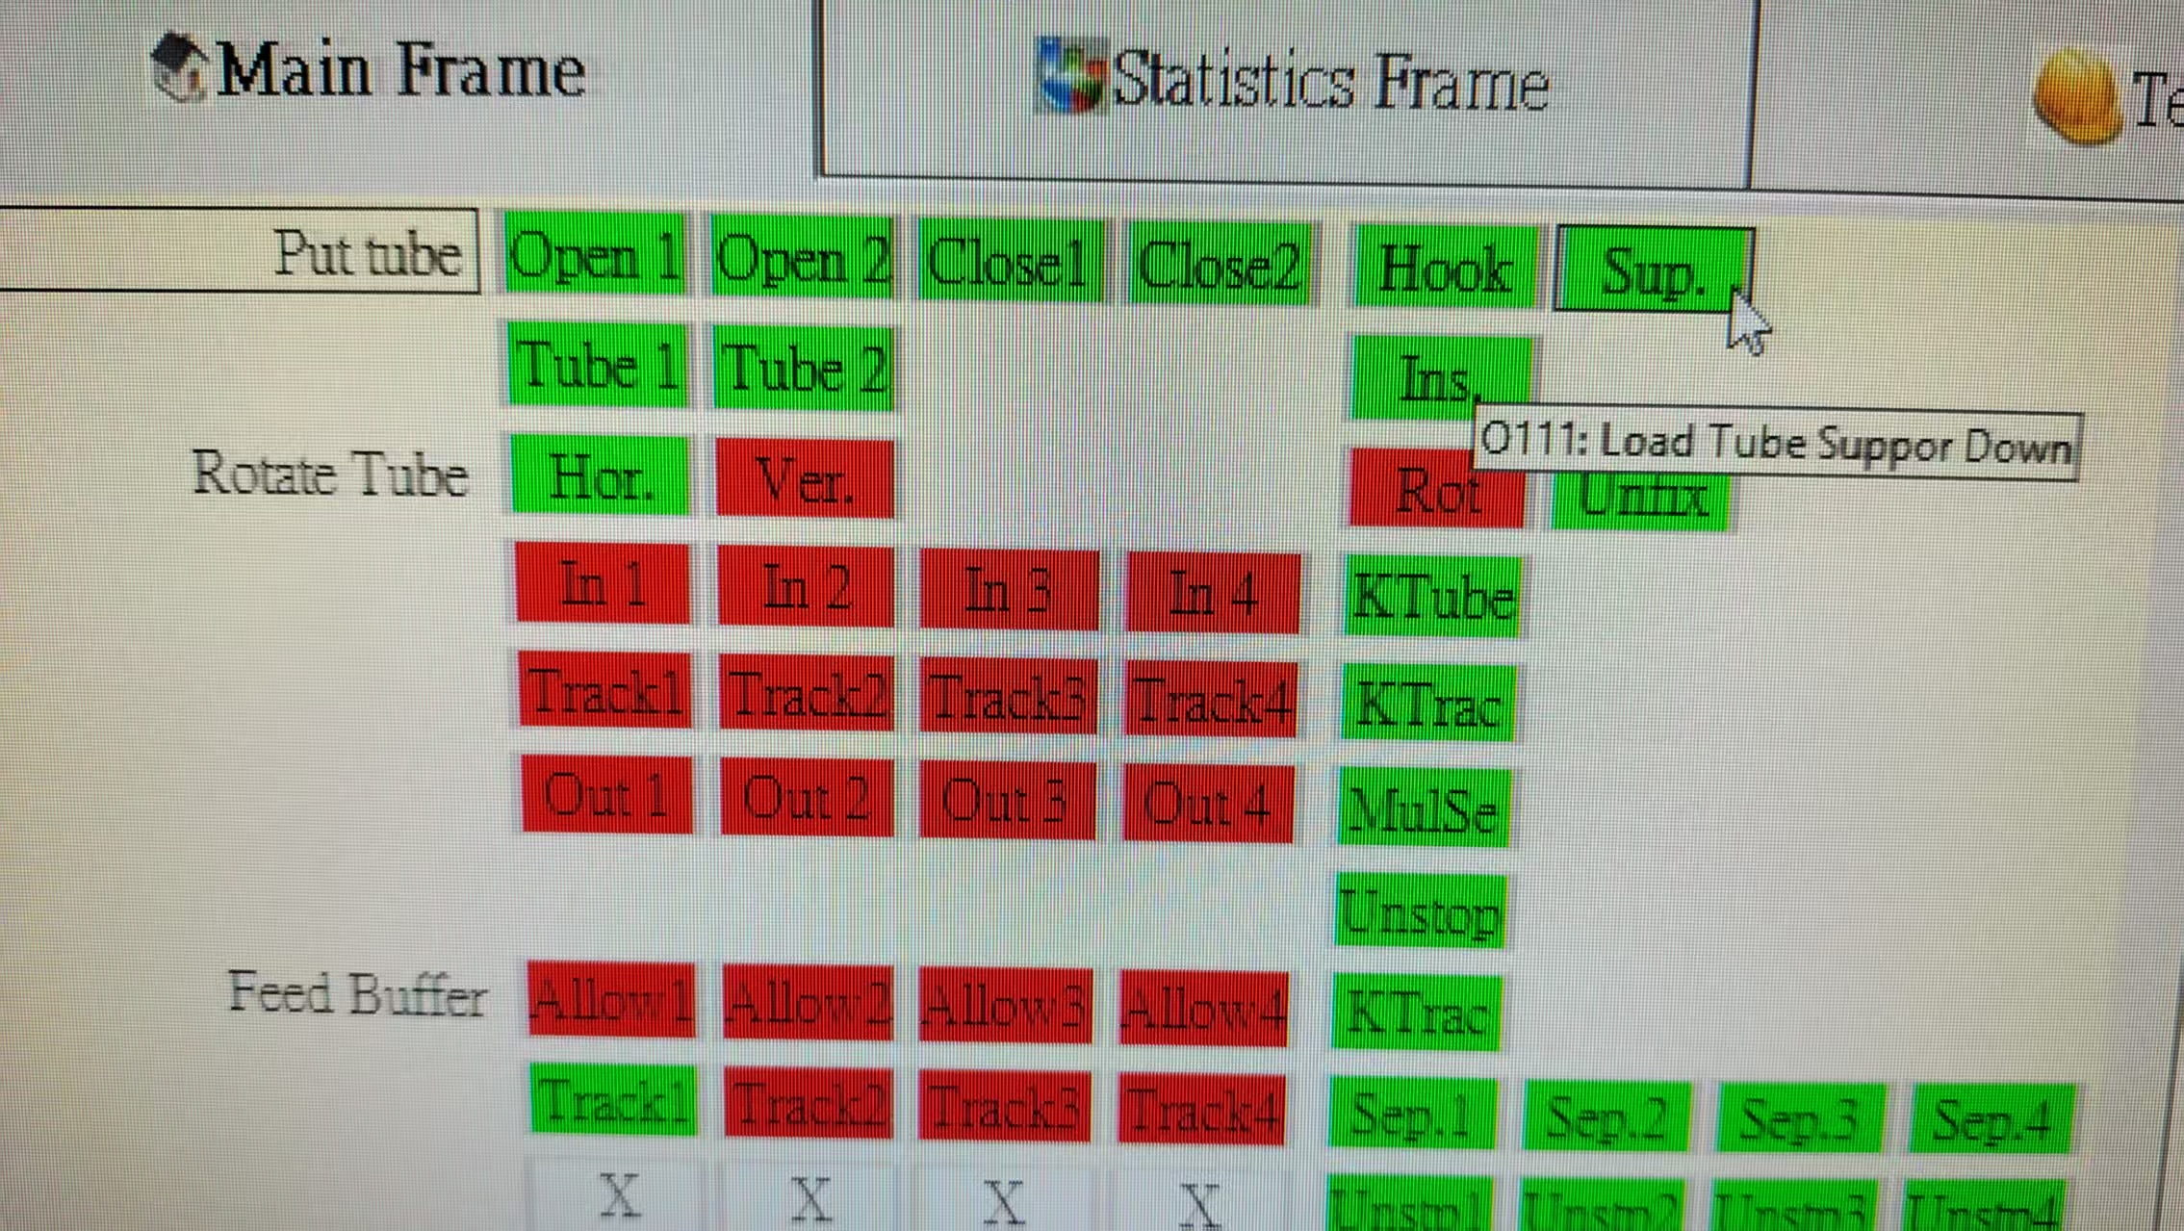
入料調整步驟
Loader tube adjustment steps
2放一支管子,調整有無料管的sensor(i111,i113),撐管(O111)向上時,sensor不亮,撐管向下時,sensor要亮
2. Put a tube and adjust the sensor (i111,i113),. When the Supporting tube(O111) is upward, the sensor is not lit. When the Supporting tube is downward, the sensor should be lit.
Put tube adjustment steps
紅色箭頭為相對應的零件
The red arrows indicate the corresponding parts

Slide 5
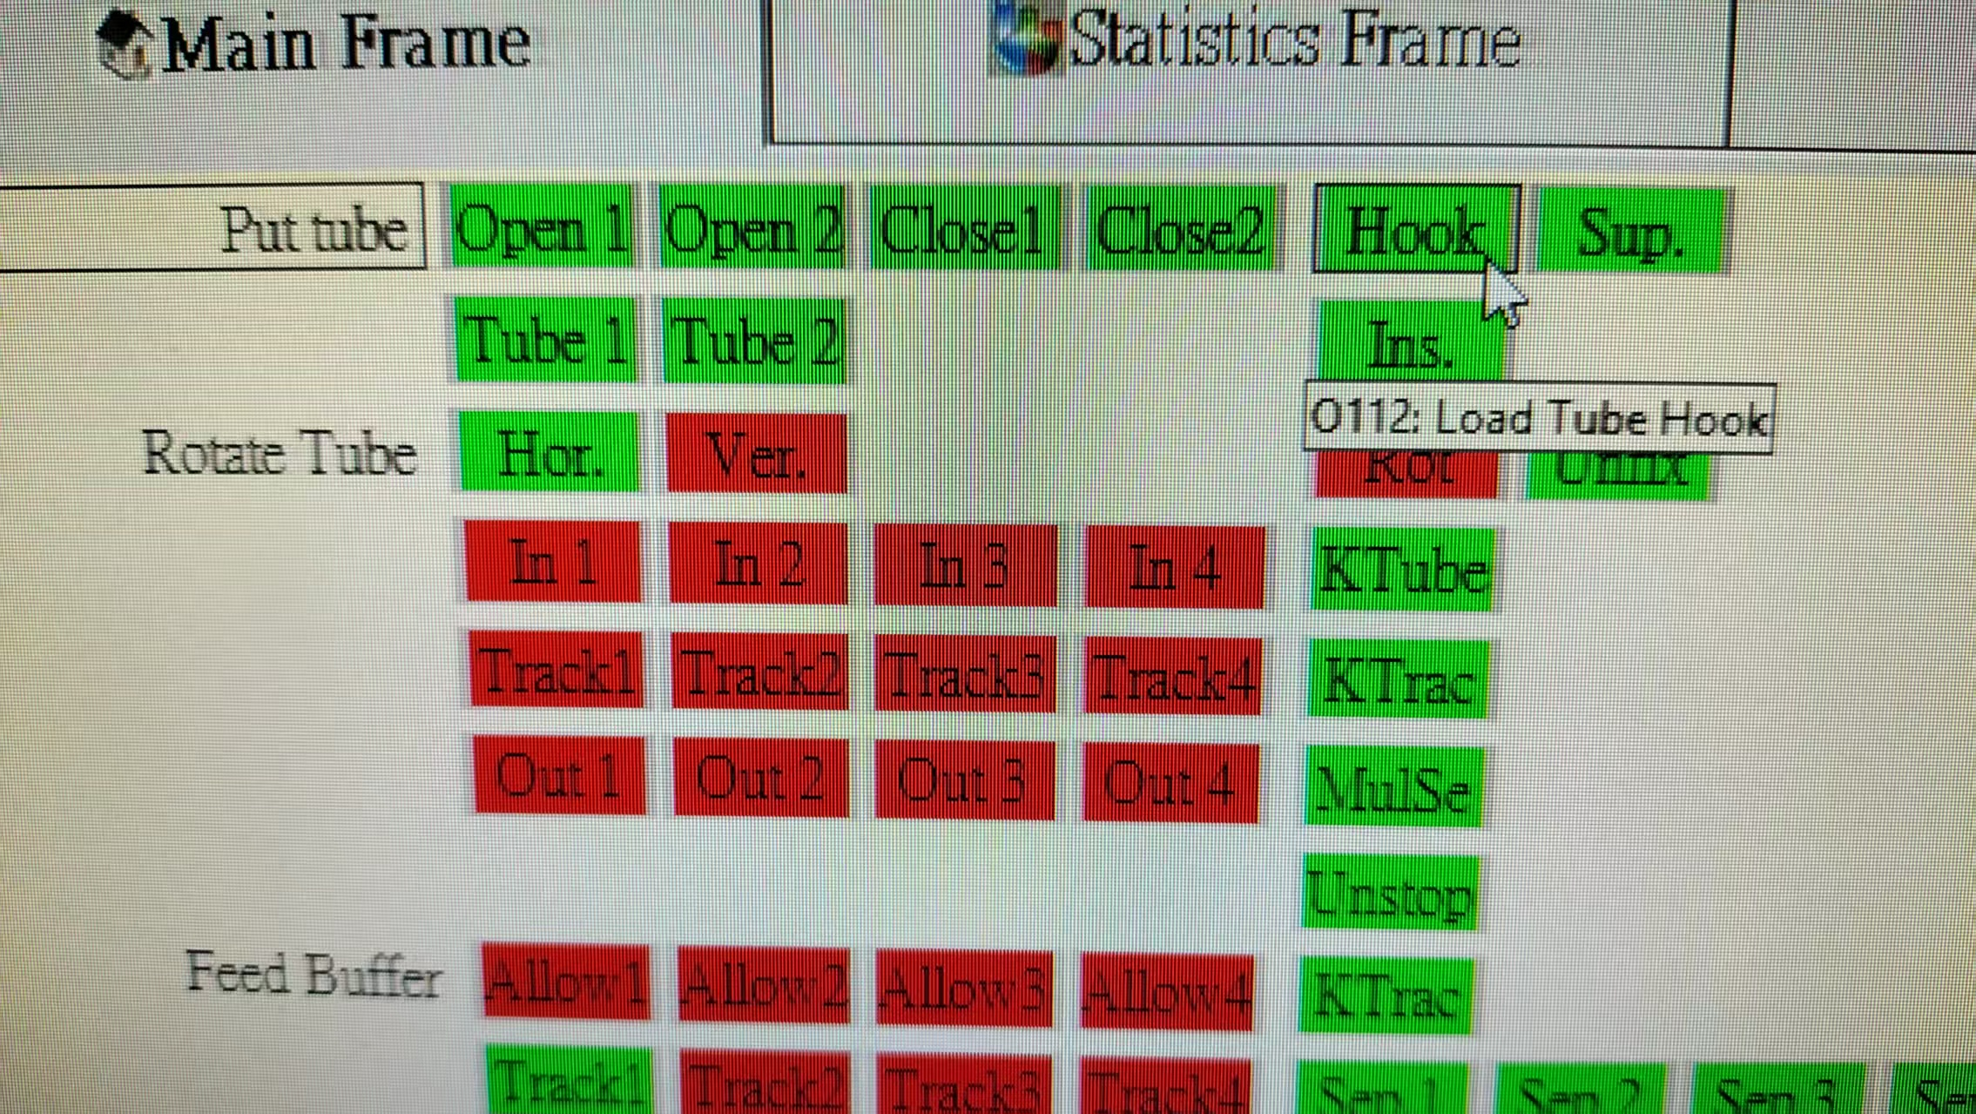
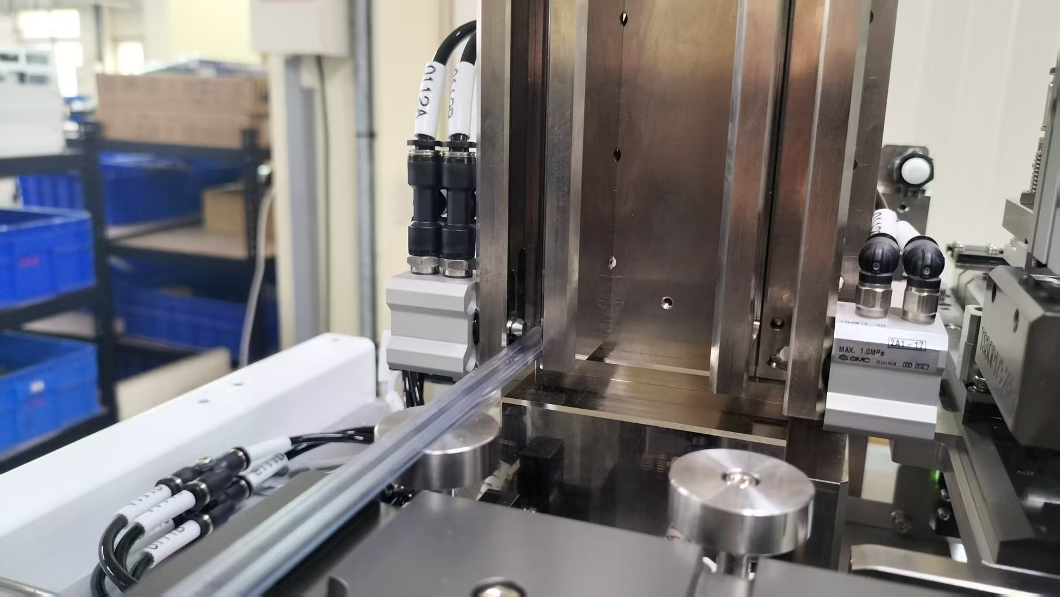
入料調整步驟
Loader tube adjustment steps
3 放二支管子時,勾管(O112)要勾住第二管,不能勾住第一管
3 When placing two tube, the hook(O112) should be hooked on the second tube, not the first tube.
Put tube adjustment steps
紅色箭頭為相對應的零件
The red arrows indicate the corresponding parts

